Slide 1
Synaptic Model

Slide 2


Synaptic model
In order to model the short term plasticity we used two ODEs
The first equation models the vesicle depletion process where the number of vesicles, R(t) is decreased with u(t)R(t) after release due to presynaptic spike at time $t_{AP}.$
Between spikes, R(t) recovers to 1 with a depression time constant D.

Slide 3
Synaptic model
The second equation models the dynamics of the release probability u(t) which increases with f[1-u(t)] after every presynaptic spike, decaying back to baseline release probability U with a facilitation time constant F.

Slide 4


Synaptic model
The equations were numerically integrated between the nth and the (n+1)th spike and the following equations were reached
The nth post synaptic current is then given by $EPSC_{n}=AR_{n}u_{n}$. Where A is the amplification factor which is constant for each EPSC.

Slide 5
Simulation 1
Testing the model parameters

Slide 6
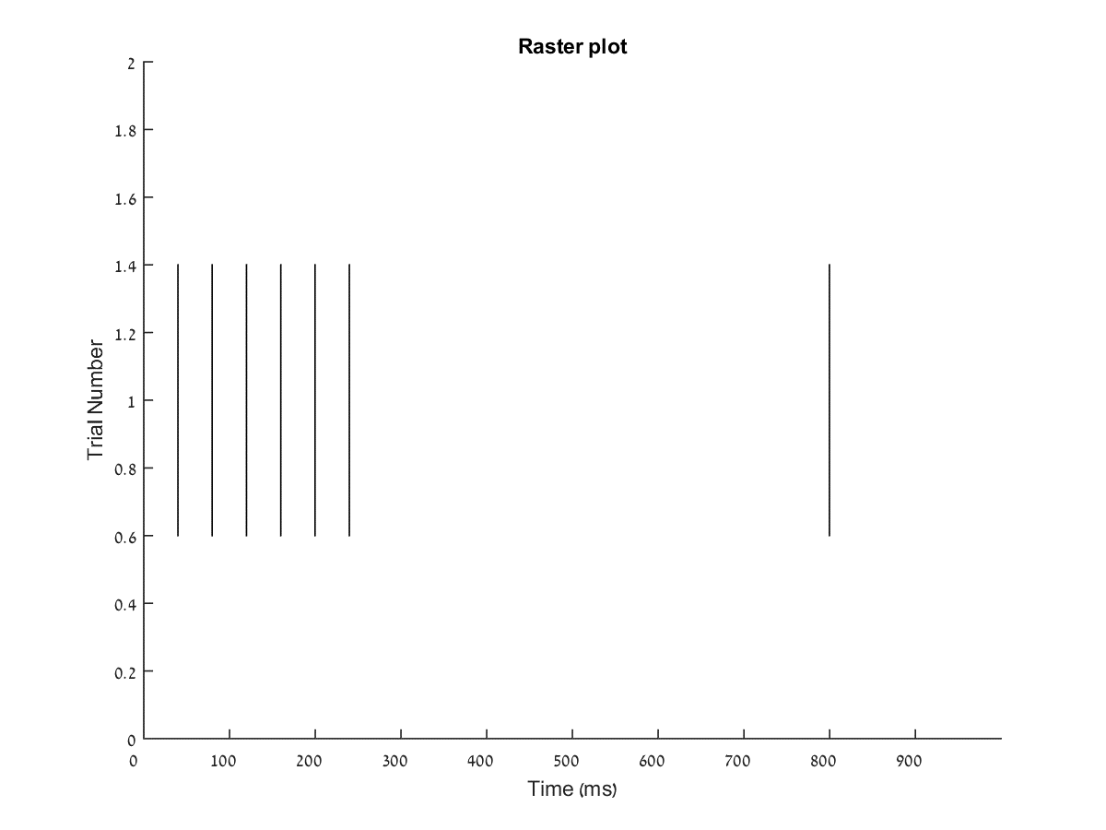
Presynaptic firing and model parameters
In order to test the parameters suggested by the paper Probabilistic inference of short-term synaptic plasticity in neocortical microcircuits, we set the presynaptic firing to the pattern shown on the right and used varying parameters which are shown in the table on the left.
6 presynaptic spikes were given at a constant interval and then a 7th spike was given after a pause long enough for the model to return to resting state.
f | U | F(s) | D(s) | Synaptic dynamics regime
0.05 | 0.7 | 0.02 | 1.7 | Strong depression
0.05 | 0.5 | 0.05 | 0.5 | Depression
0.3 | 0.25 | 0.2 | 0.2 | Facilitation-depression
0.15 | 0.15 | 0.5 | 0.05 | Facilitation
0.11 | 0.1 | 1.7 | 0.02 | Strong facilitation

Slide 7
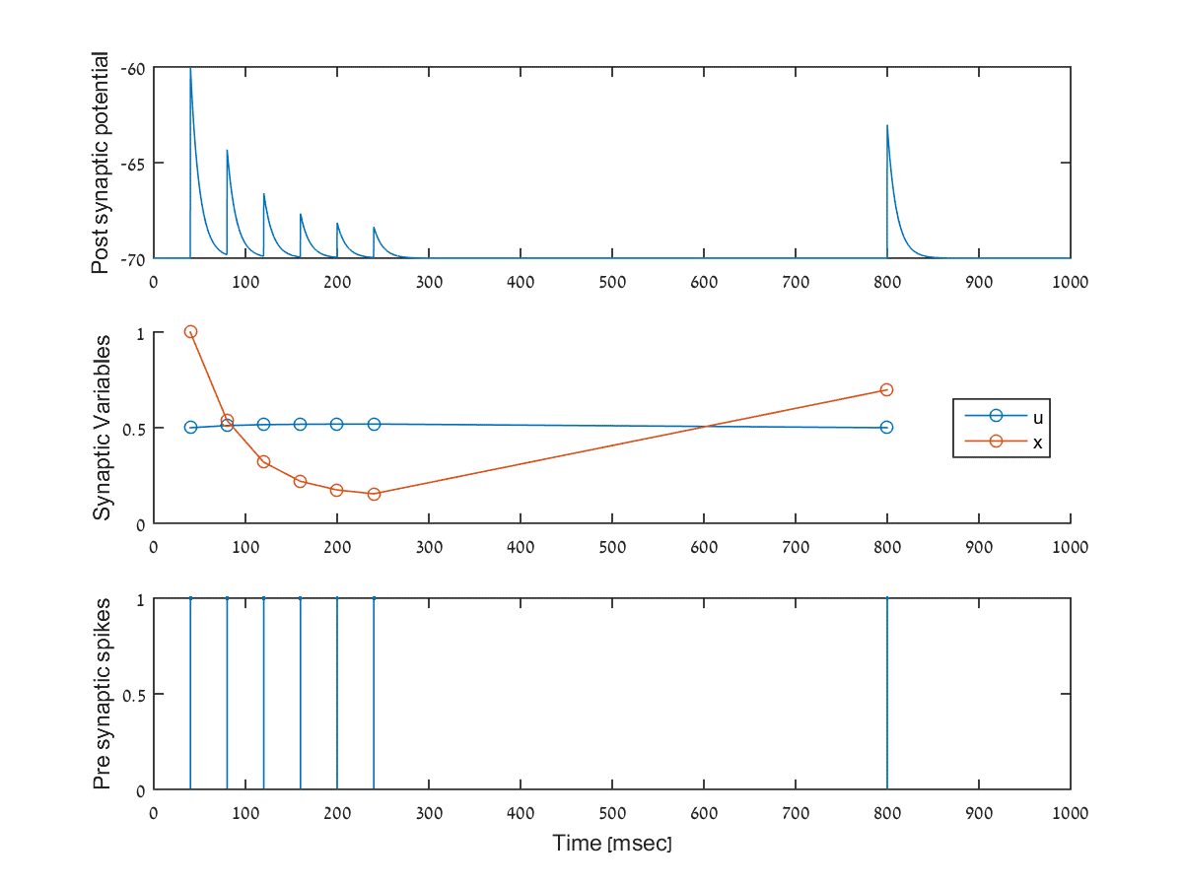
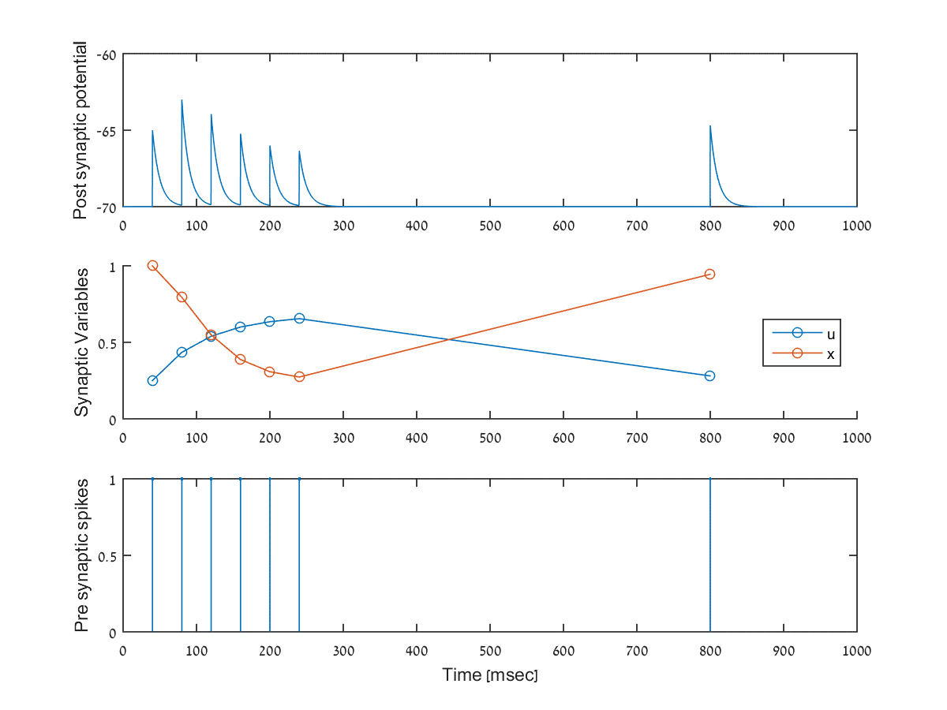
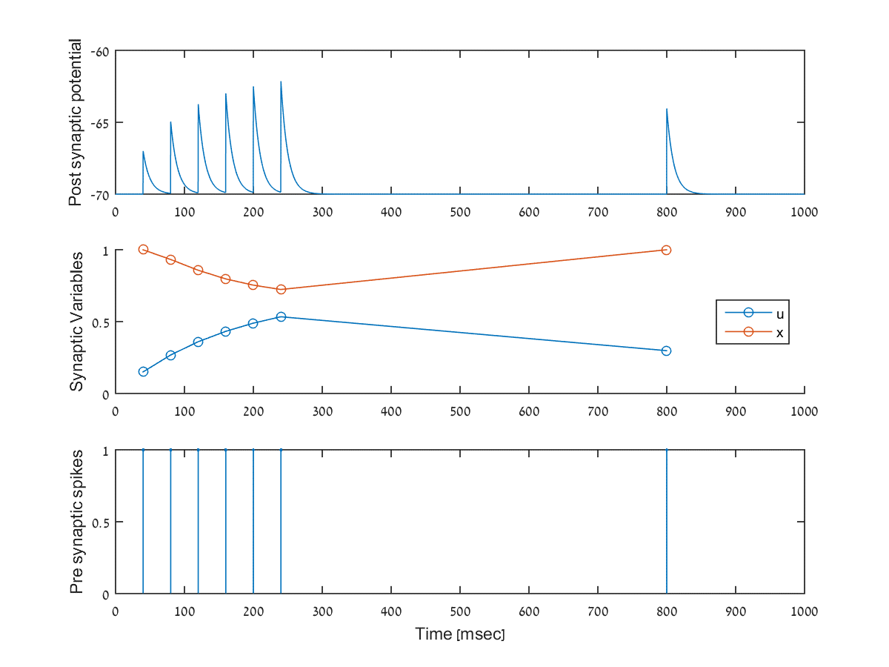
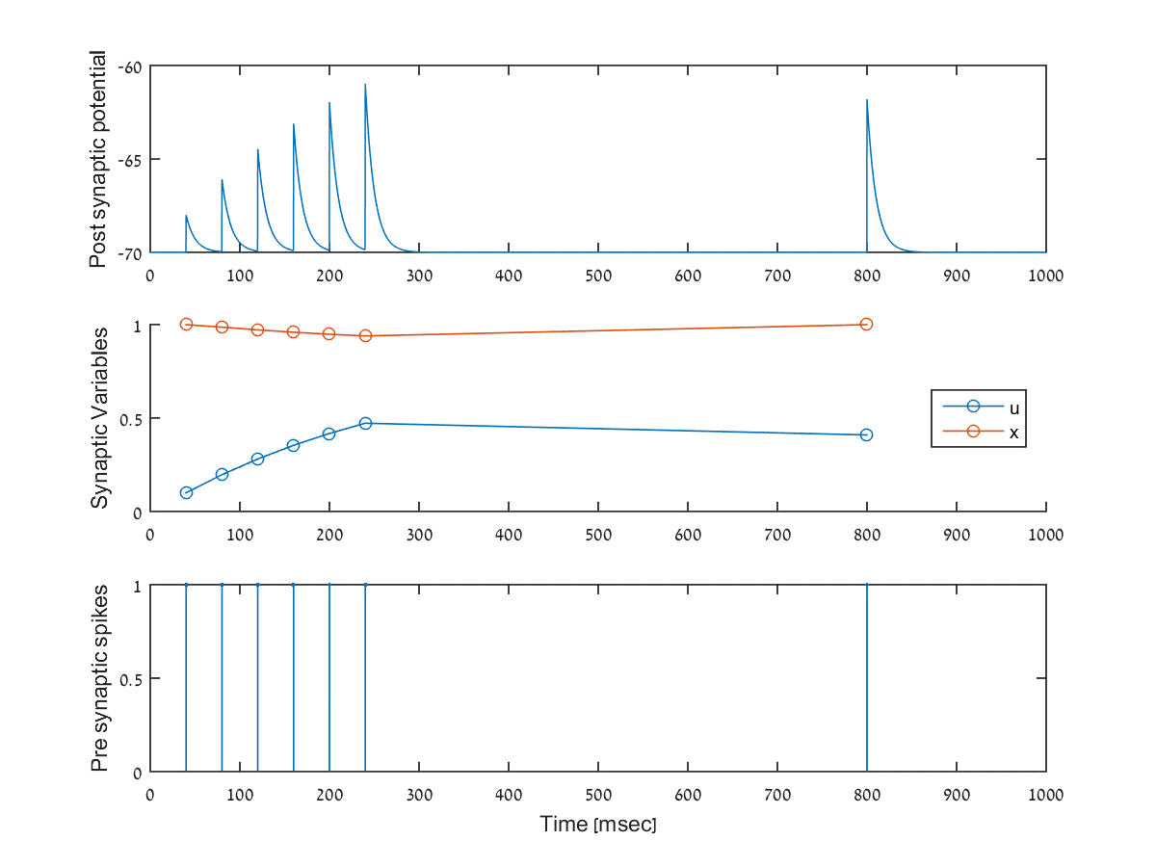
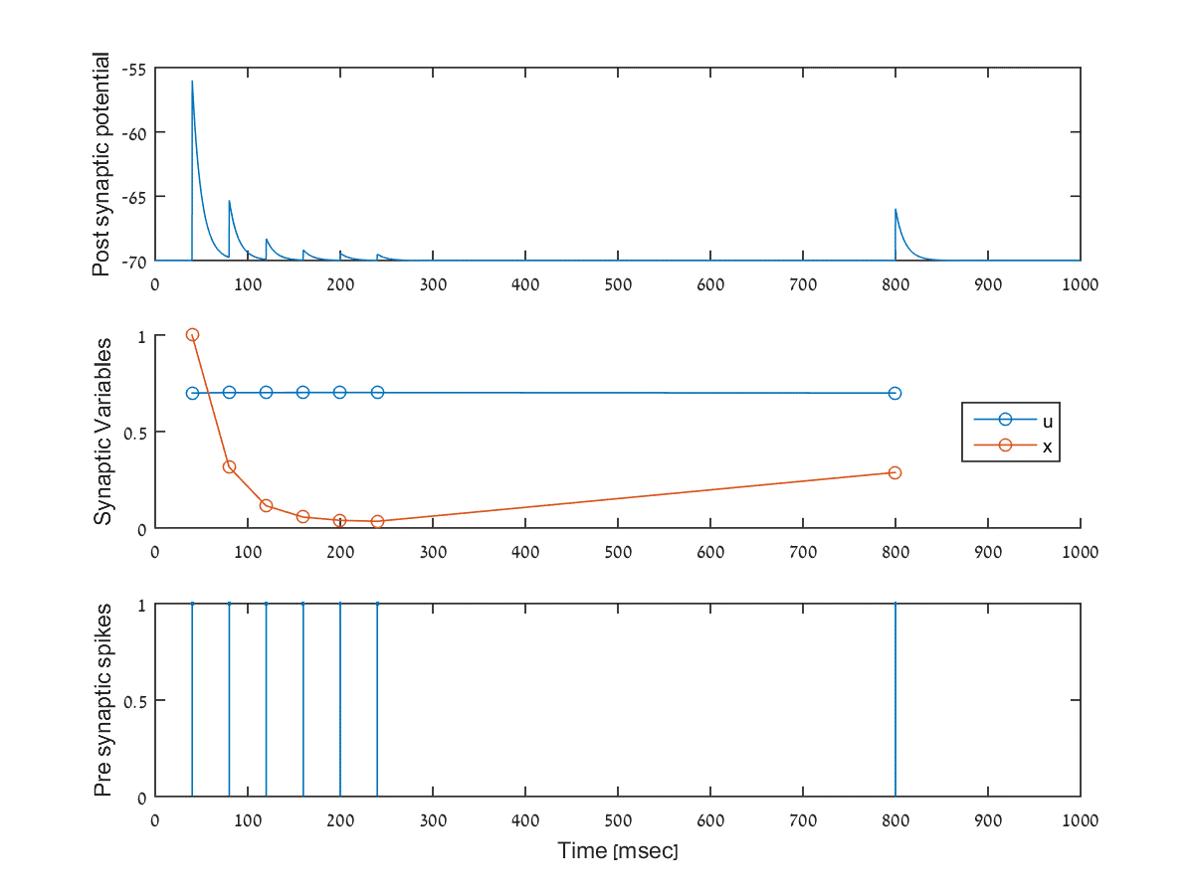
Testing the model parameters
Here we see the behavior of the post synaptic potential as well as the synaptic parameters behavior and the presynaptic spikes over time.

Slide 8
Simulation 1 - Conclusion
We can see that moving on the scale between strong depression and strong facilitation, we’re getting higher and higher paired-pulse-ratio.
We can see that the parameters that cause synaptic depression would result in PPR lower than 1 and the parameters that cause synaptic facilitation result in PPR greater than 1, as expected.
From this we can deduct that the suggested model parameters fit our model and we can carry on to further more complex simulations.

Slide 9
Simulation 2
Network response to varying synaptic variables

Slide 10
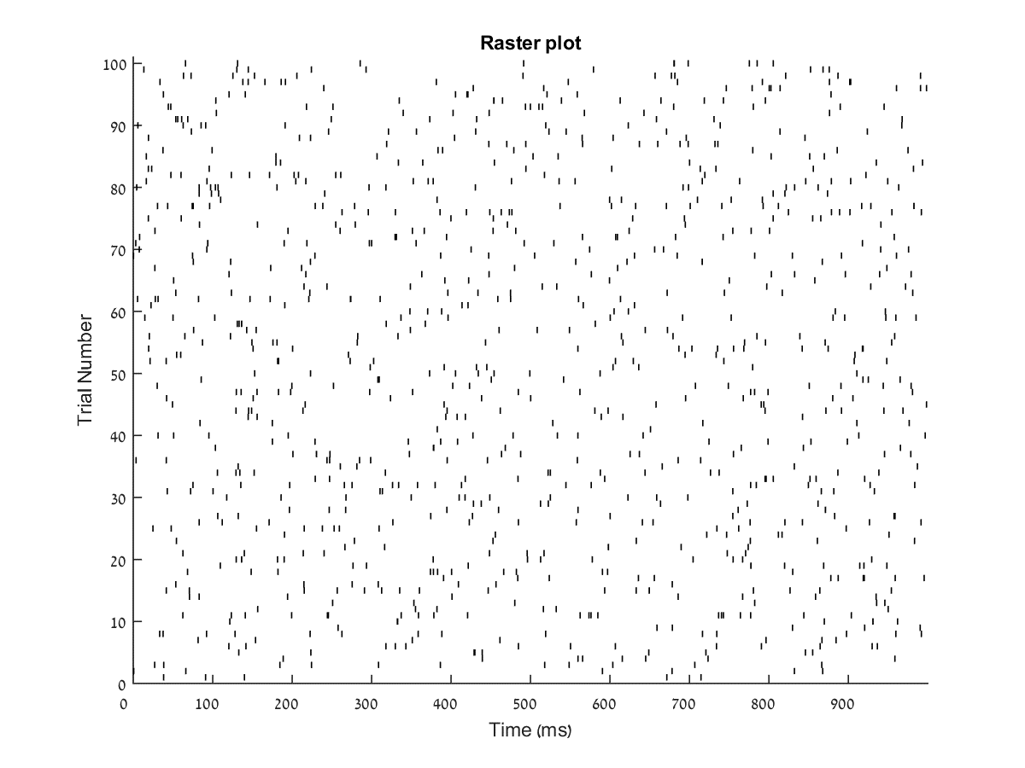
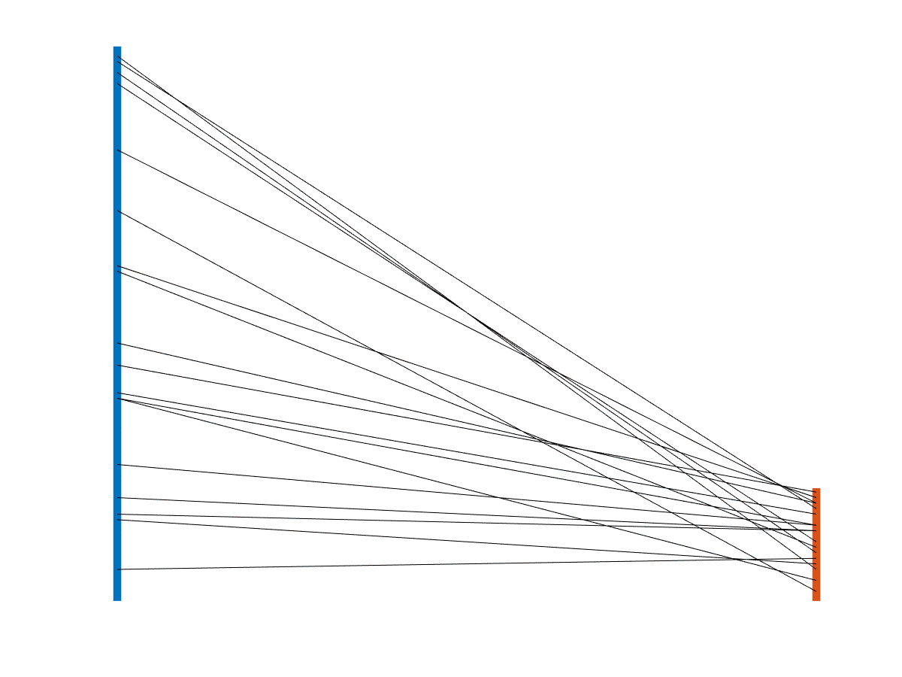
Presynaptic raster plot and connectivity map
For this simulation, we set the presynaptic spikes to fire in a Poisson rate of 10Hz. The firing rate may be viewed using the raster located on the right.
In order to visualize the connectivity between pre and post synaptic neurons, we used the plot also located on the right. The blue bar represents the presynaptic neurons and the orange bar represents the postsynaptic neurons.
The lines connecting the two bars are the connections between the neurons.

Slide 11
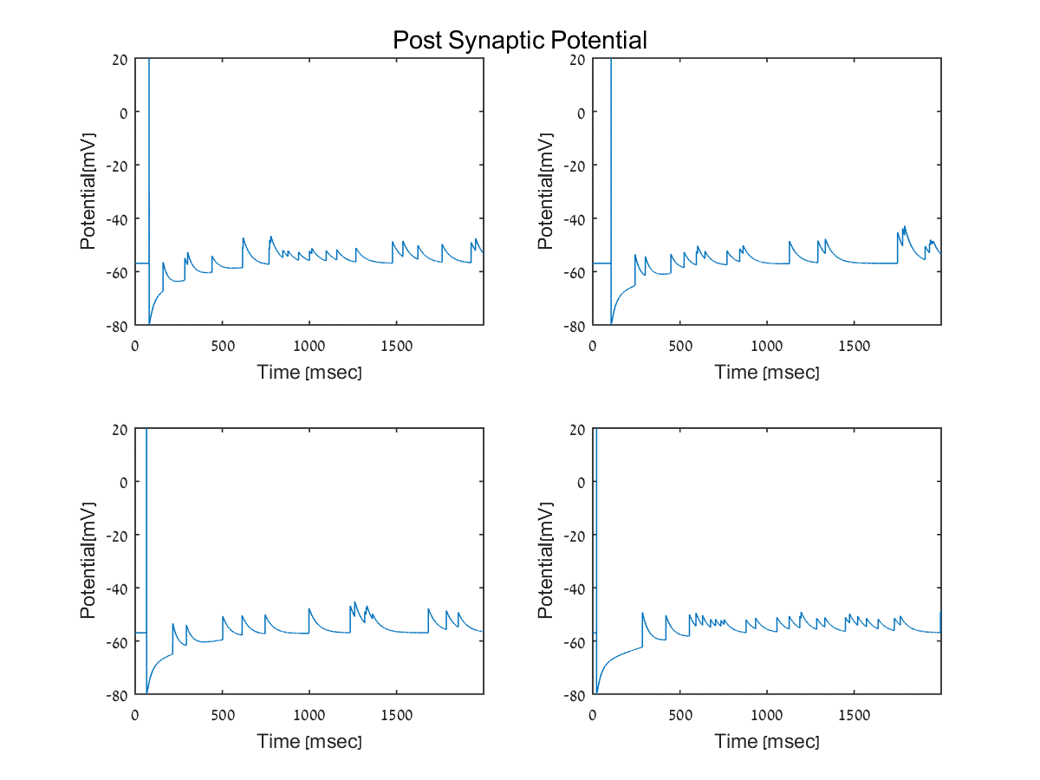
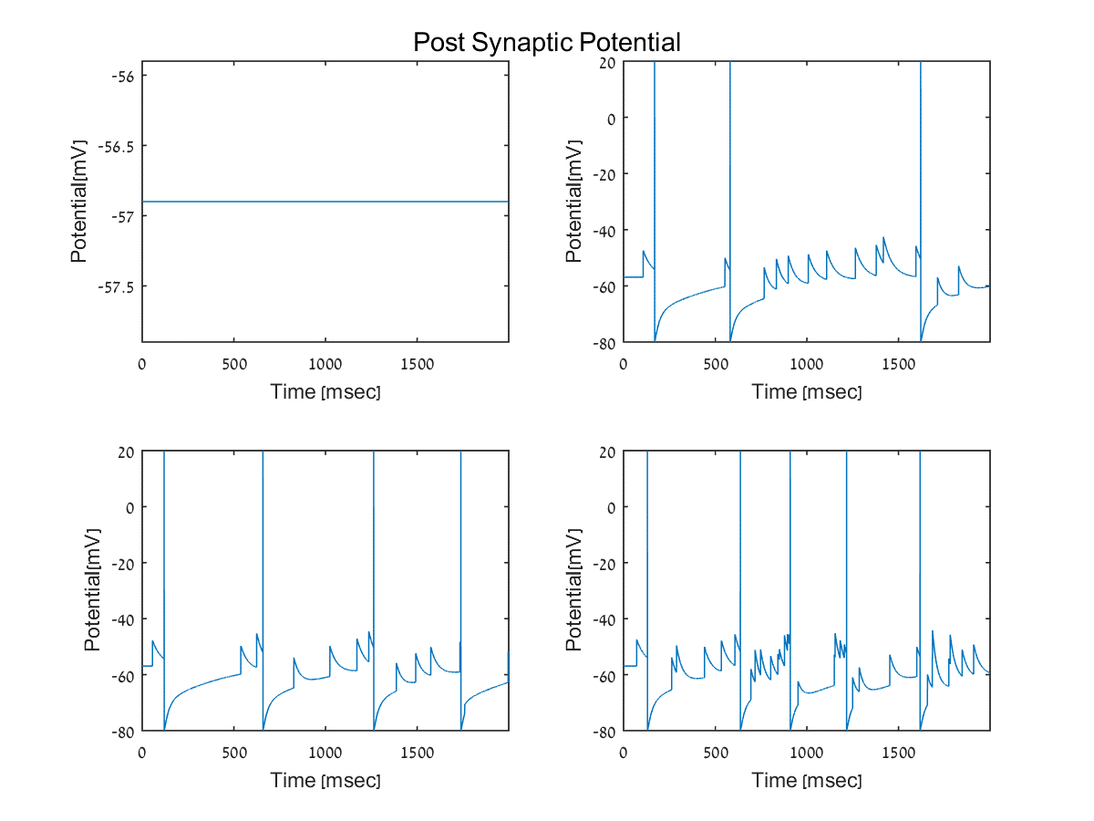
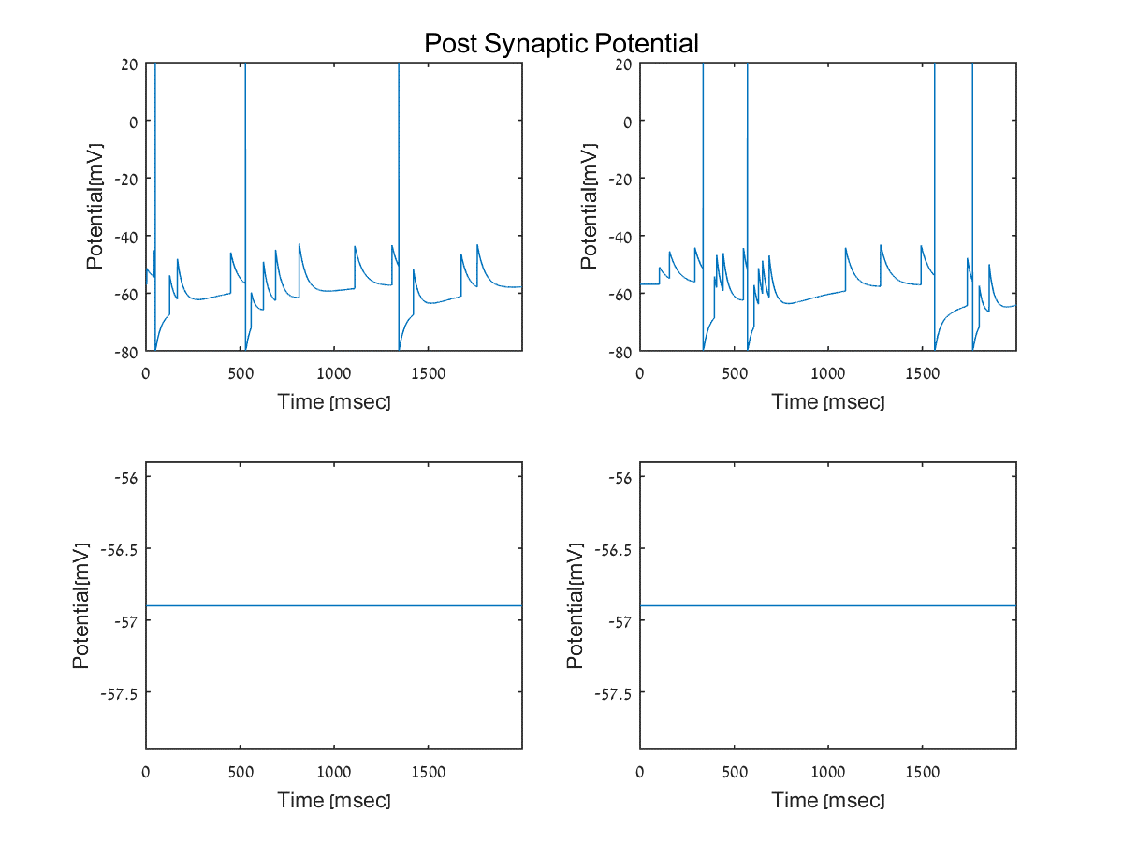
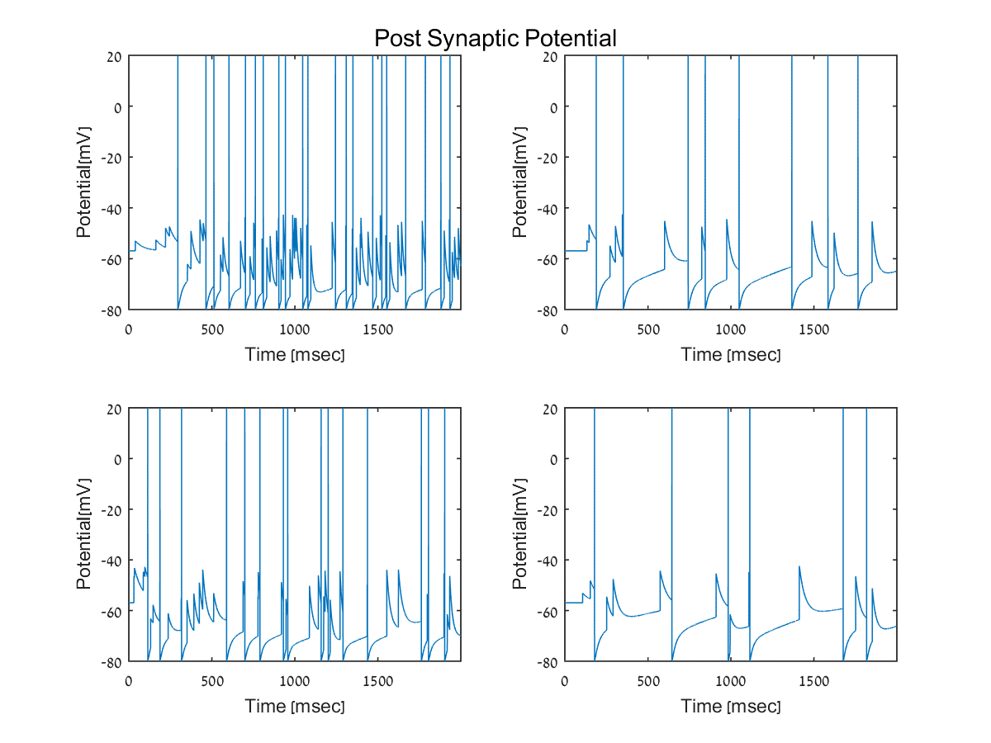
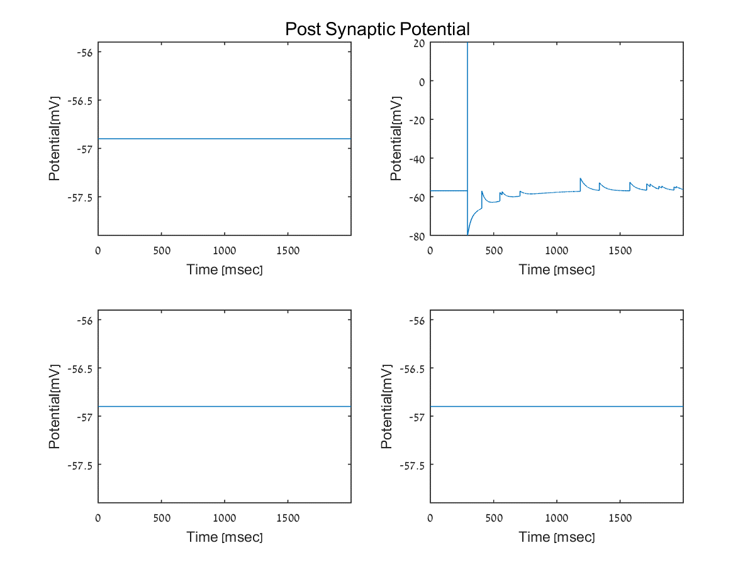
Post synaptic potential
Here we can see the post synaptic potential of 4 neurons for each mode.
This is just an example of for each mode.

Slide 12
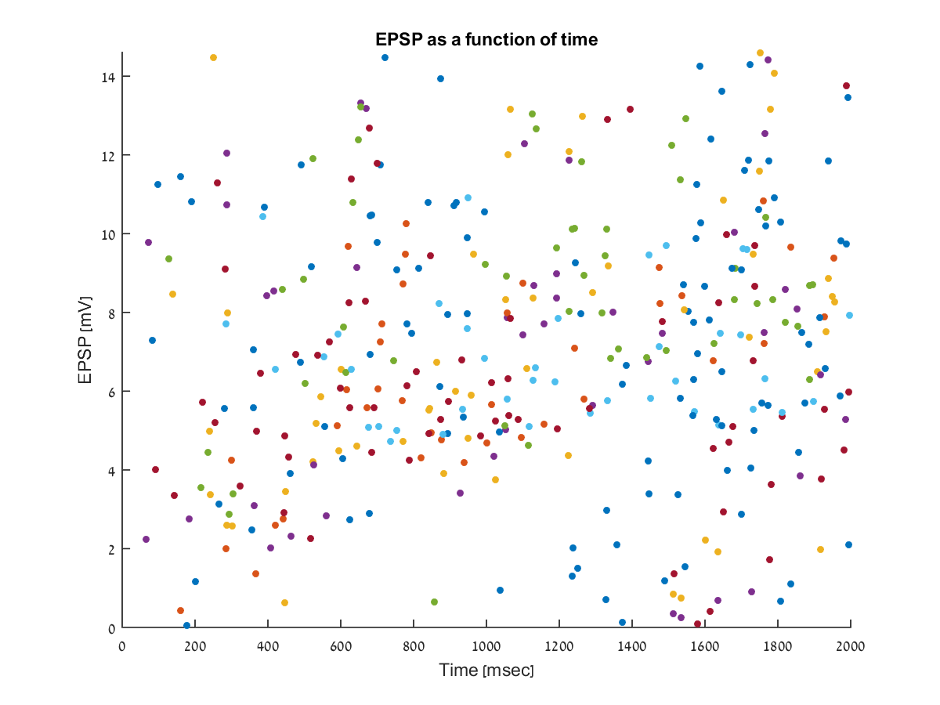
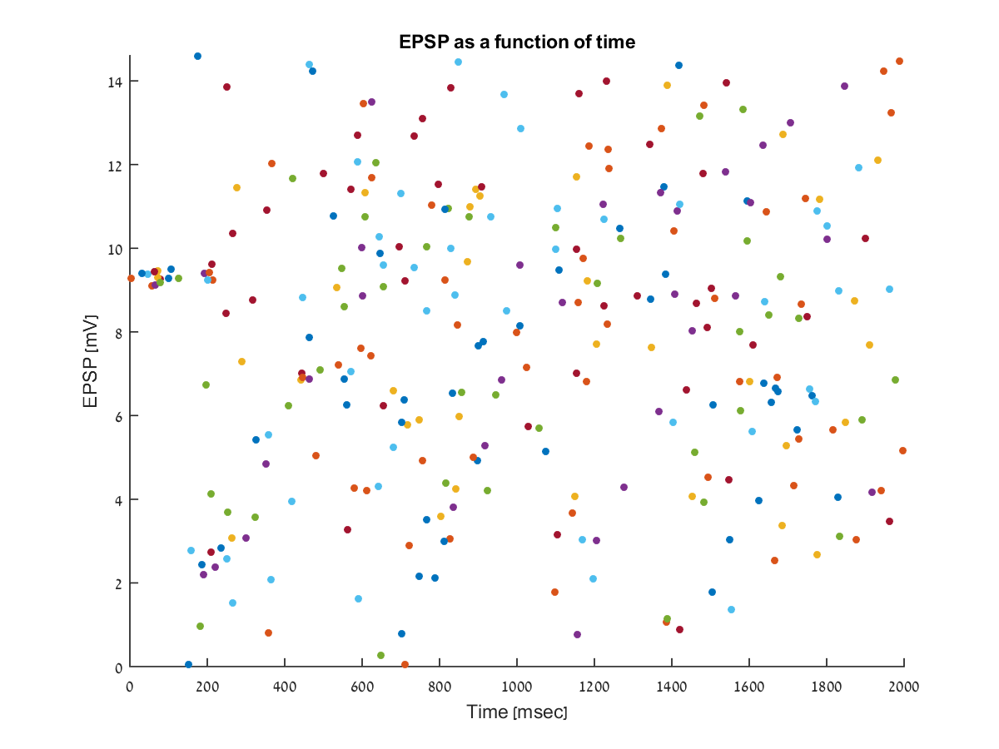
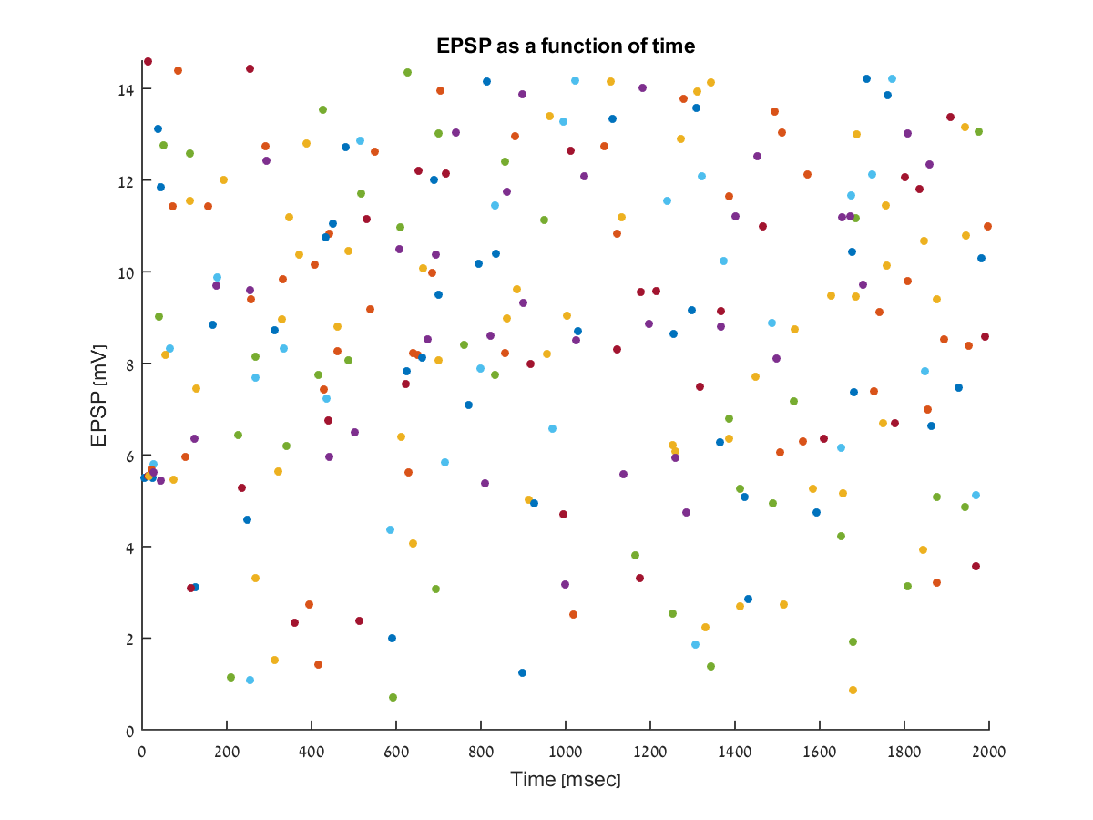
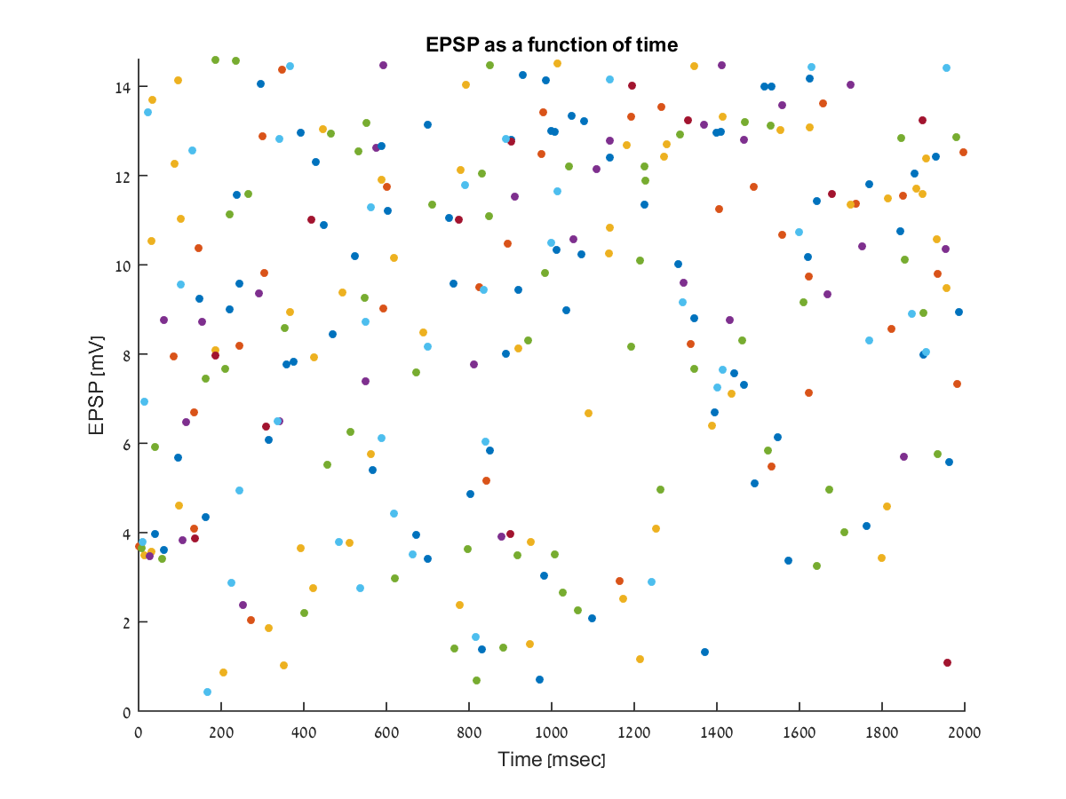
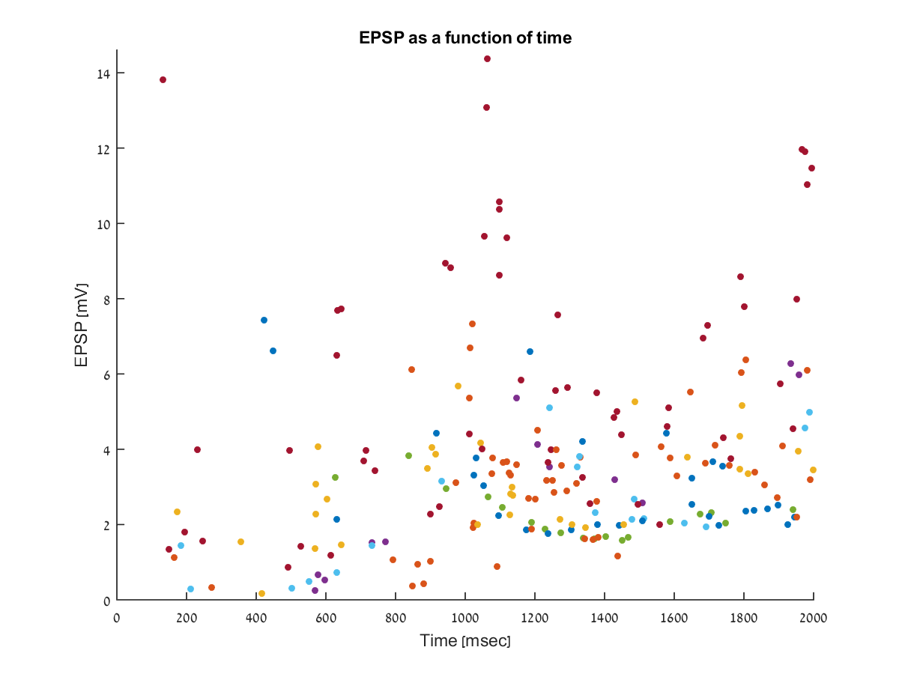
EPSP size
These plots show the peak amplitude of all post synaptic neurons.
Each color represents a different neuron.
These figures do not show neurons which passed the threshold potential

Slide 13
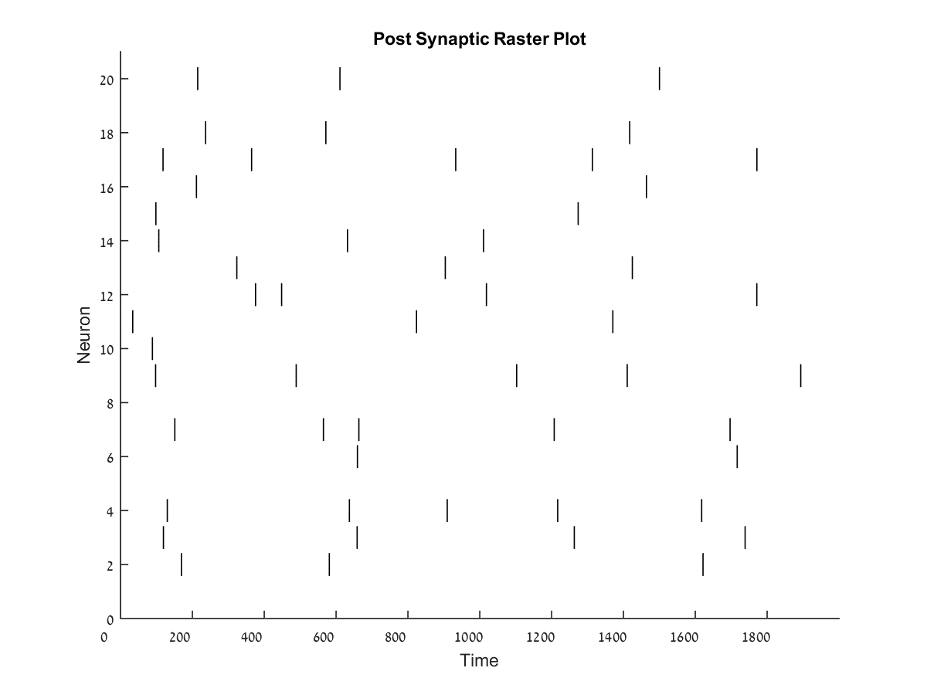
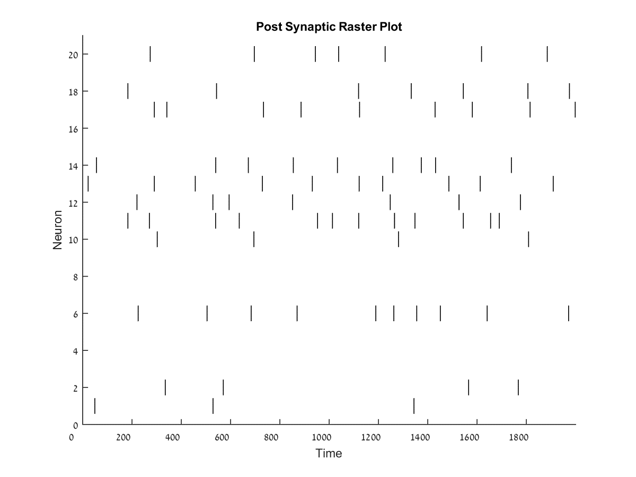
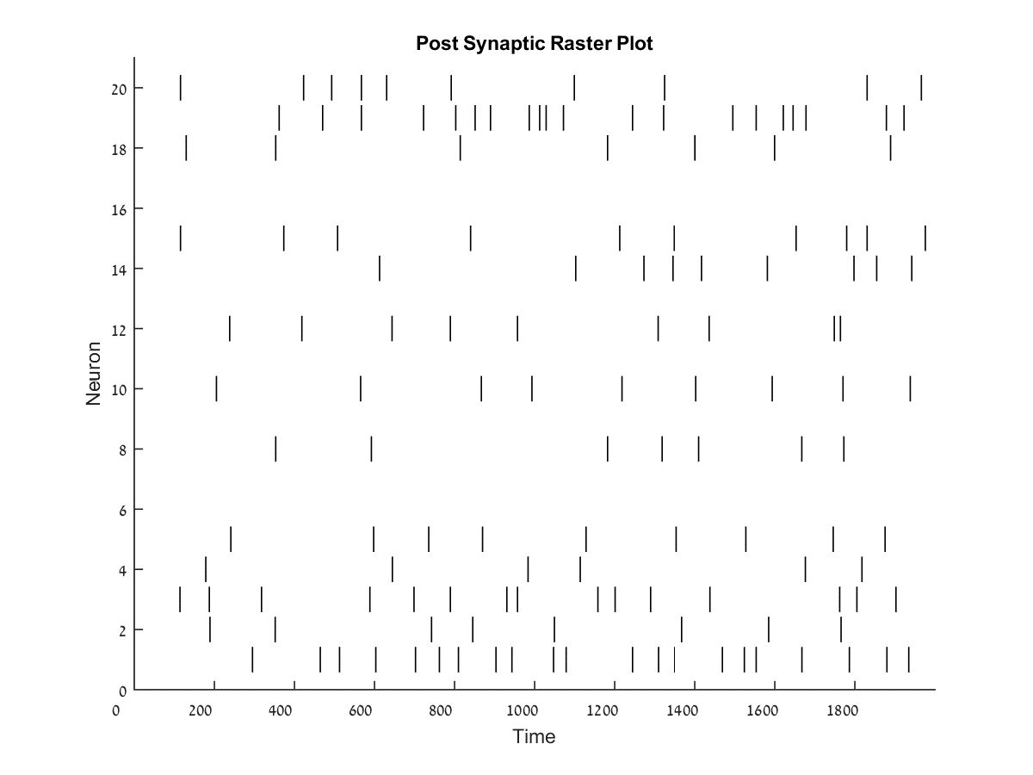
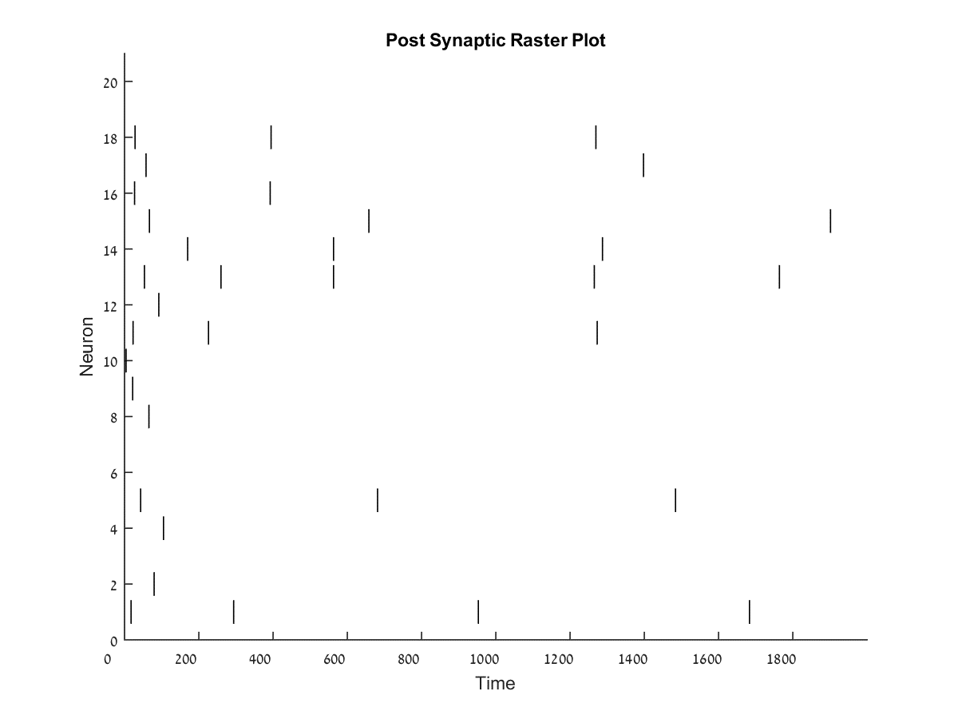
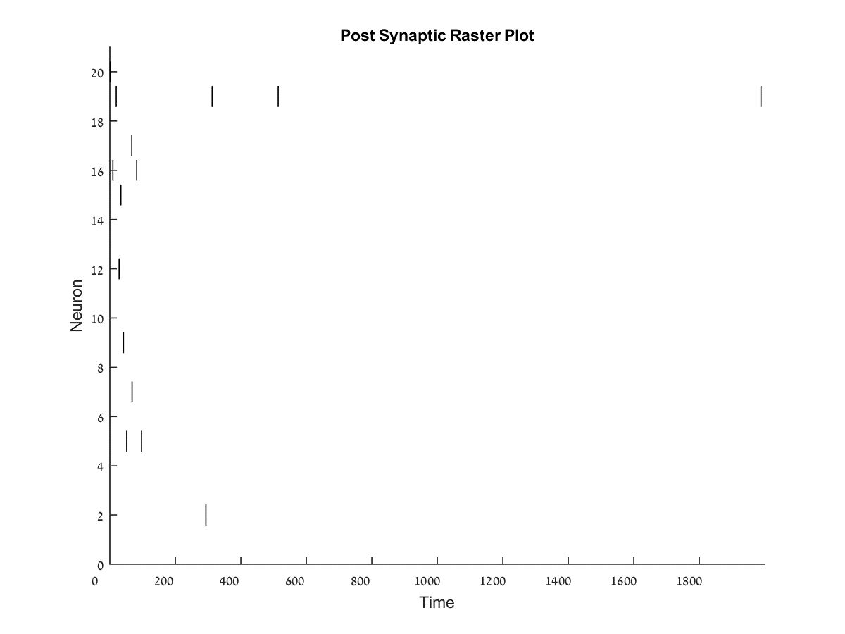
Post synaptic raster plot
Here we can view the post synaptic raster plot.
These figures show the number of neurons that passed the threshold potential in the simulation.

Slide 14
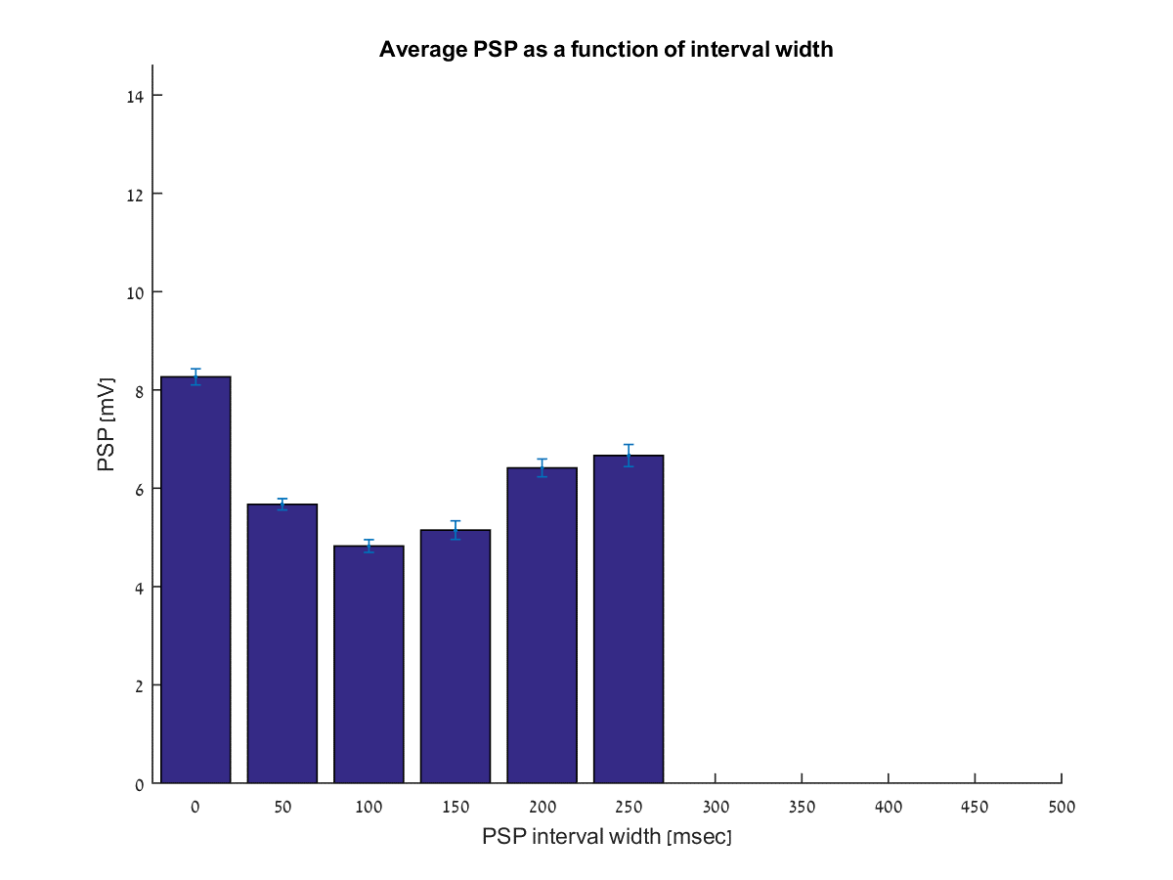
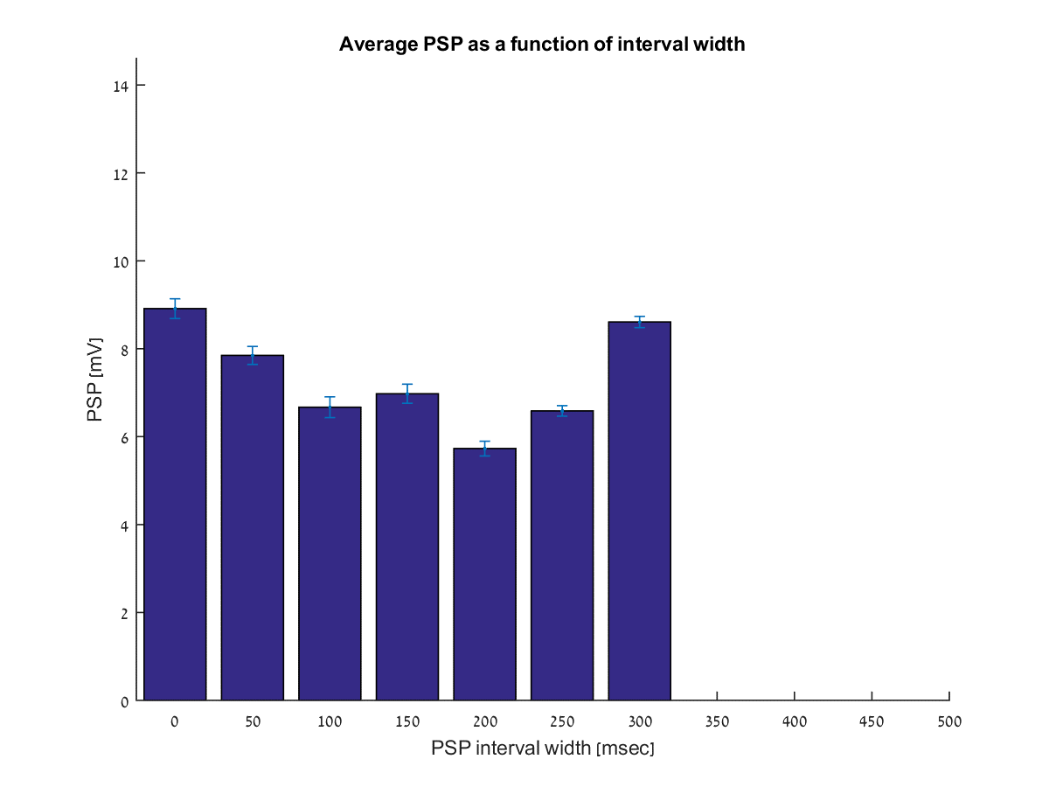
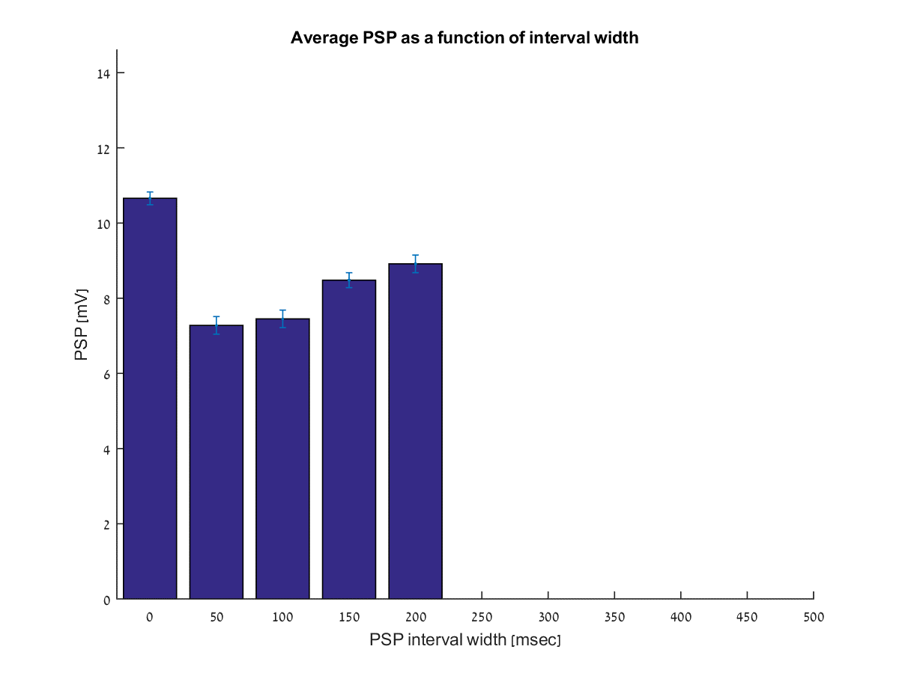
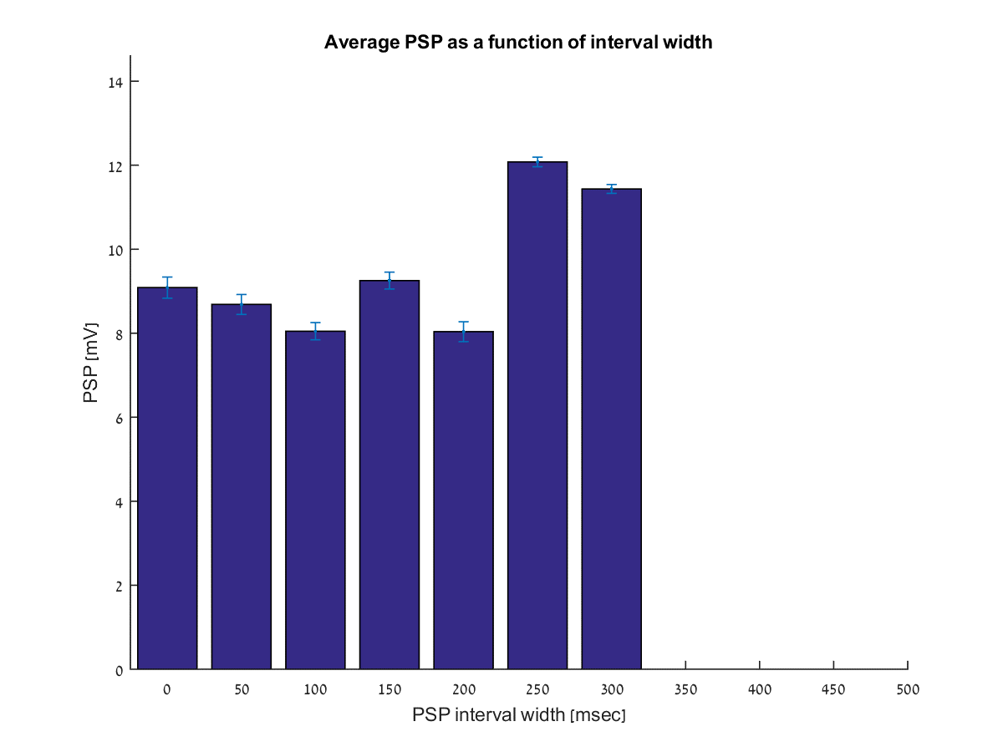
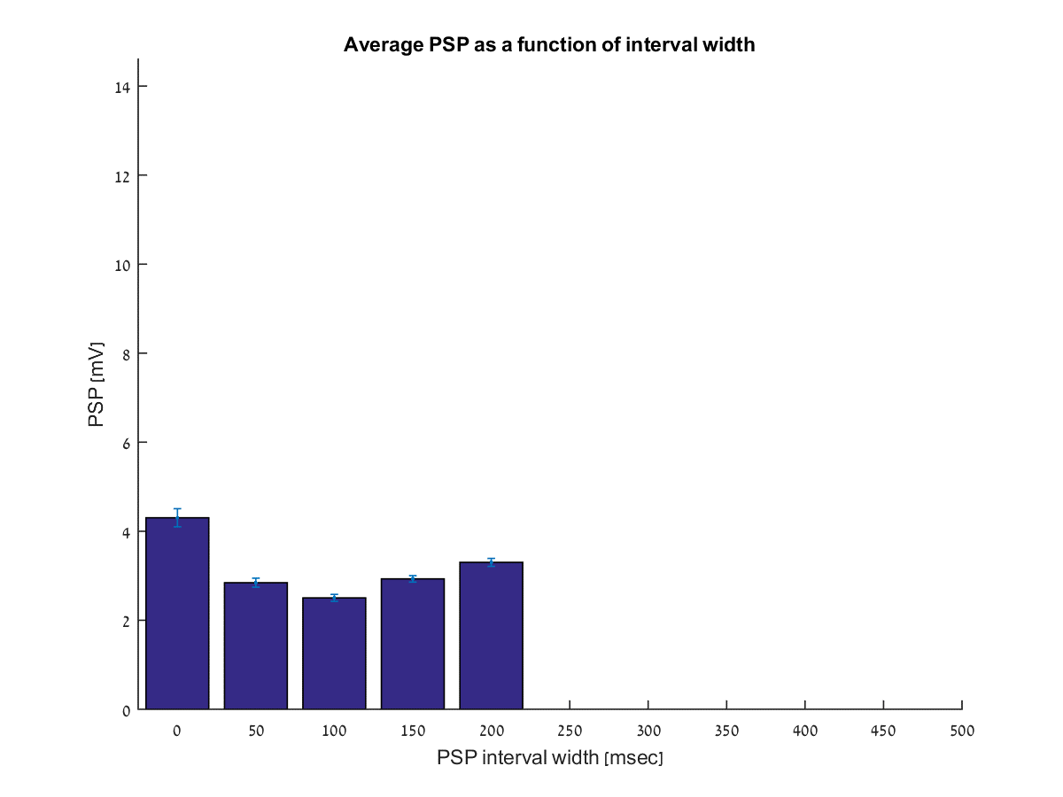
Testing the model parameters
Here we can see the average size of the EPSP as a function of the interval passed since the previous presynaptic spike.
The time interval used is 50msec.

Slide 15
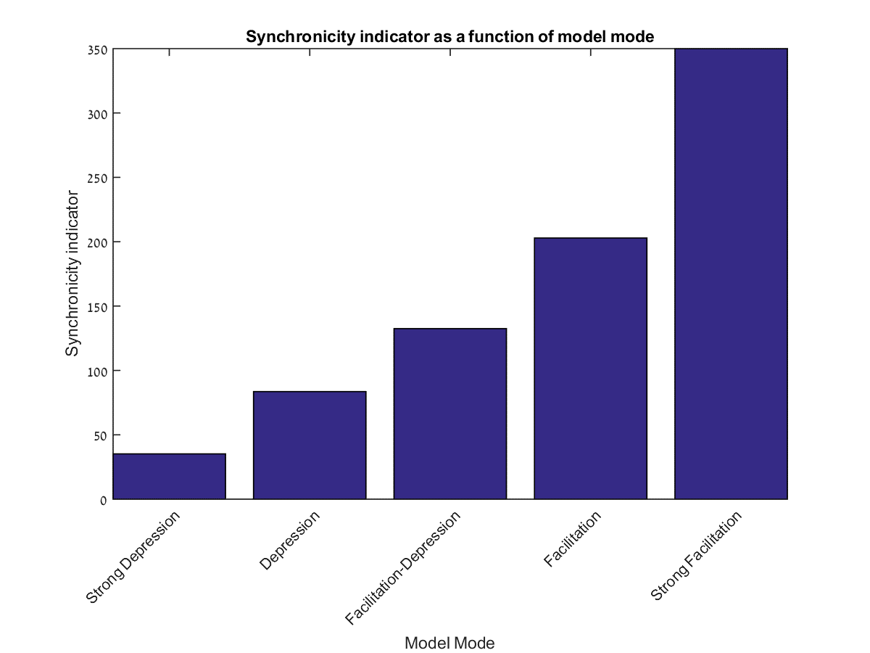
Synchronicity indicator

Slide 16
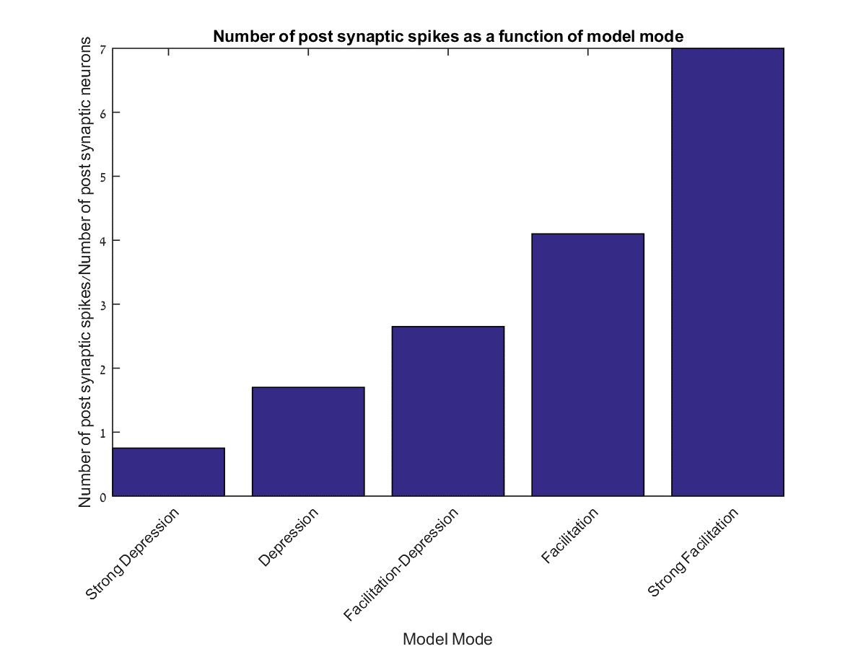
Number of post synaptic spikes

Slide 17
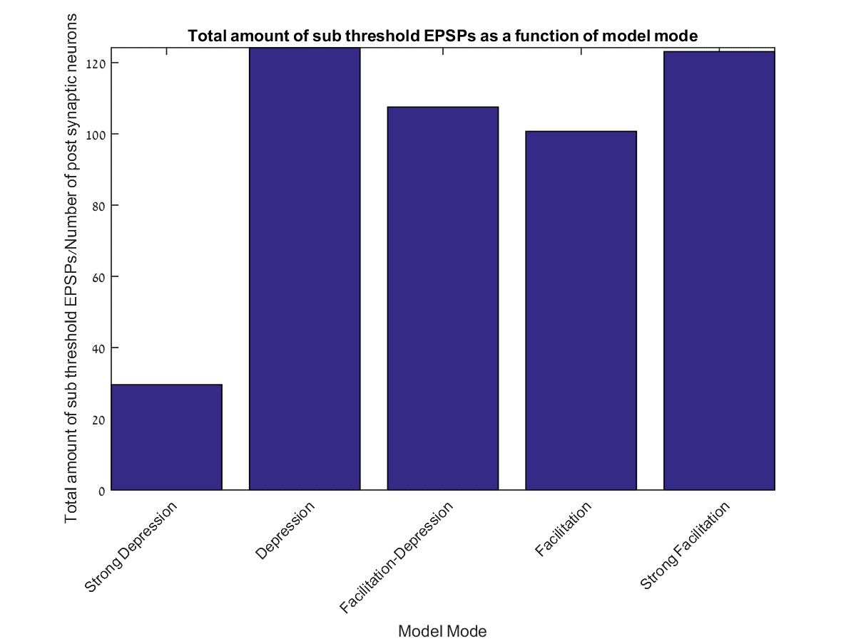
Total amount of subthreshold EPSPs

Slide 18
Simulation 2 - Conclusions
From this simulation we can see that even at the network level, we’re getting a gradient resulting from stronger facilitation.
The average EPSP size grows with the growth in facilitation.
We can see that when the model is set to strong depression, we’re getting an increase of EPSP at the longer time intervals. When the model is set to strong facilitation, we’re getting the exact opposite result in which the average EPSP is greater at the shorter time intervals.

Slide 19
Simulation 3
Adding Associational Commissural connections at different levels

Slide 20
General
In order to simulate the Associational Commissural connections, another set of connections was added to the system between the CA3 neurons to them selves.
To test the associational commissural connections, we set a gradient to the probability of these connections. The connection probability ranges between 0-0.2.
In order to measure this synchronicity, the sync index was defined as is the average number of post synaptic spikes in a predefined time interval.
Again at this simulation we set the presynaptic firing rate at 10Hz.

Slide 21

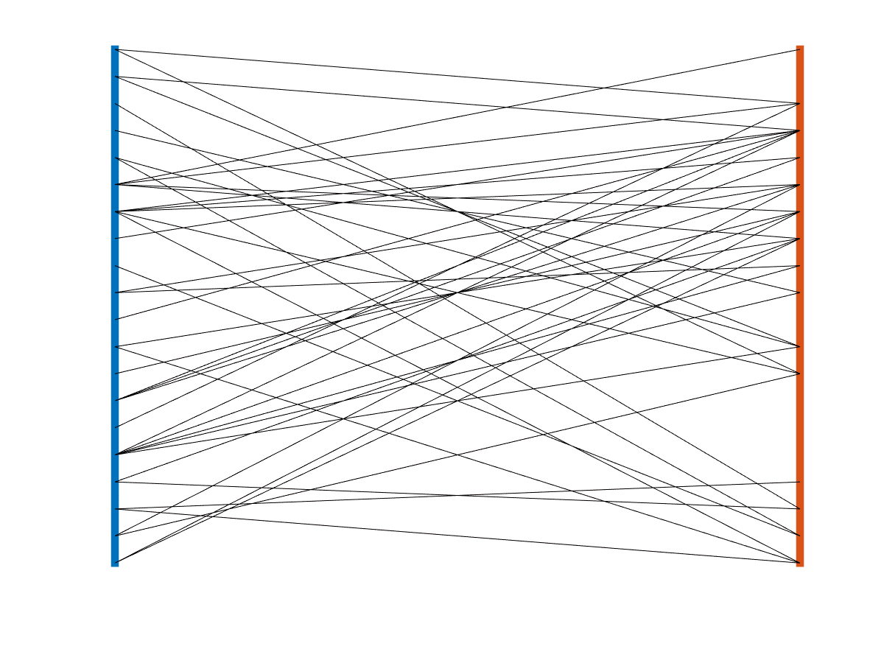
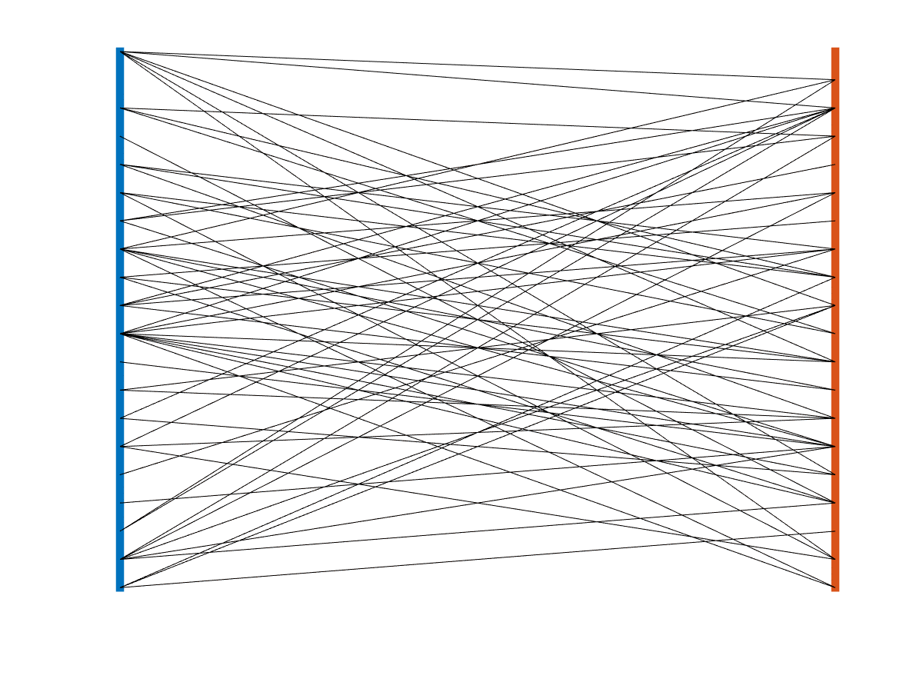
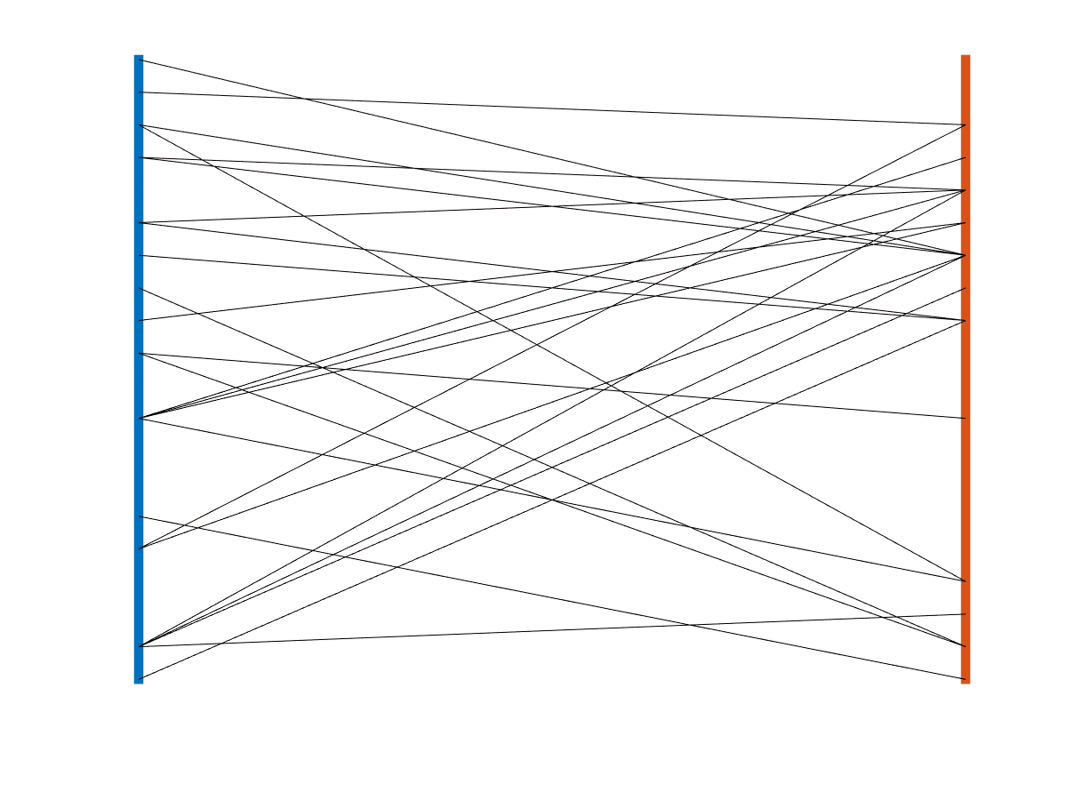
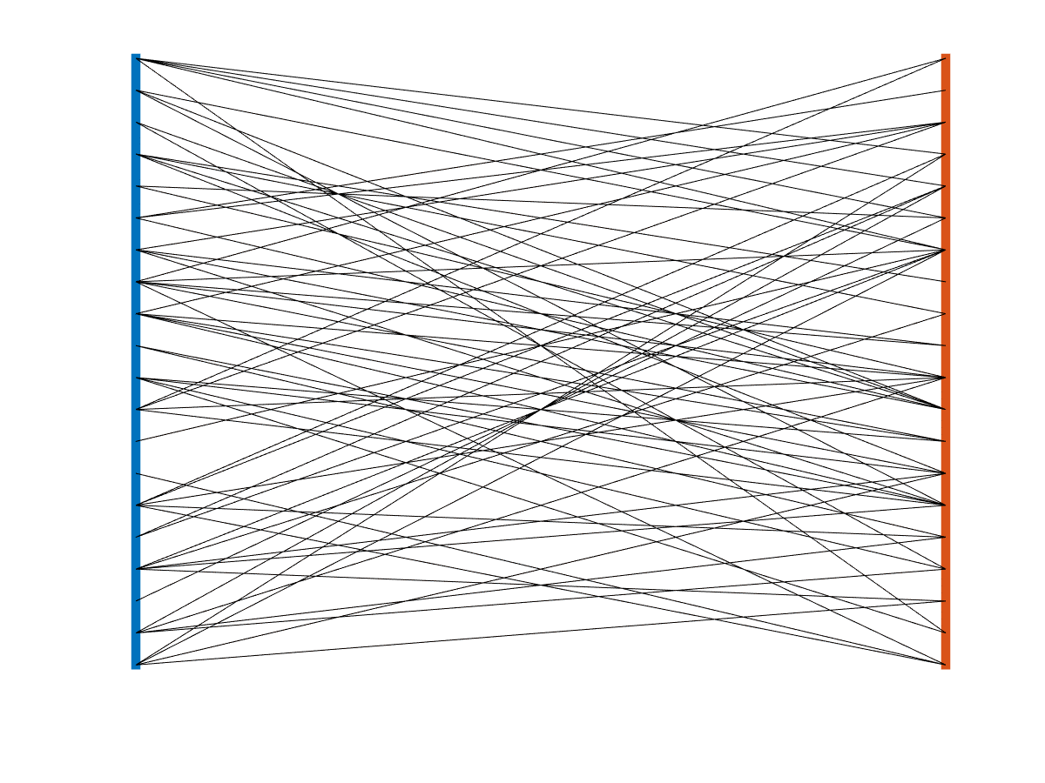
Associational commissural connectivity maps
Here we can view the connectivity map of the CA3-CA3 network.
The CA1-CA3 connectivity is the same for each of these modes.

Slide 22
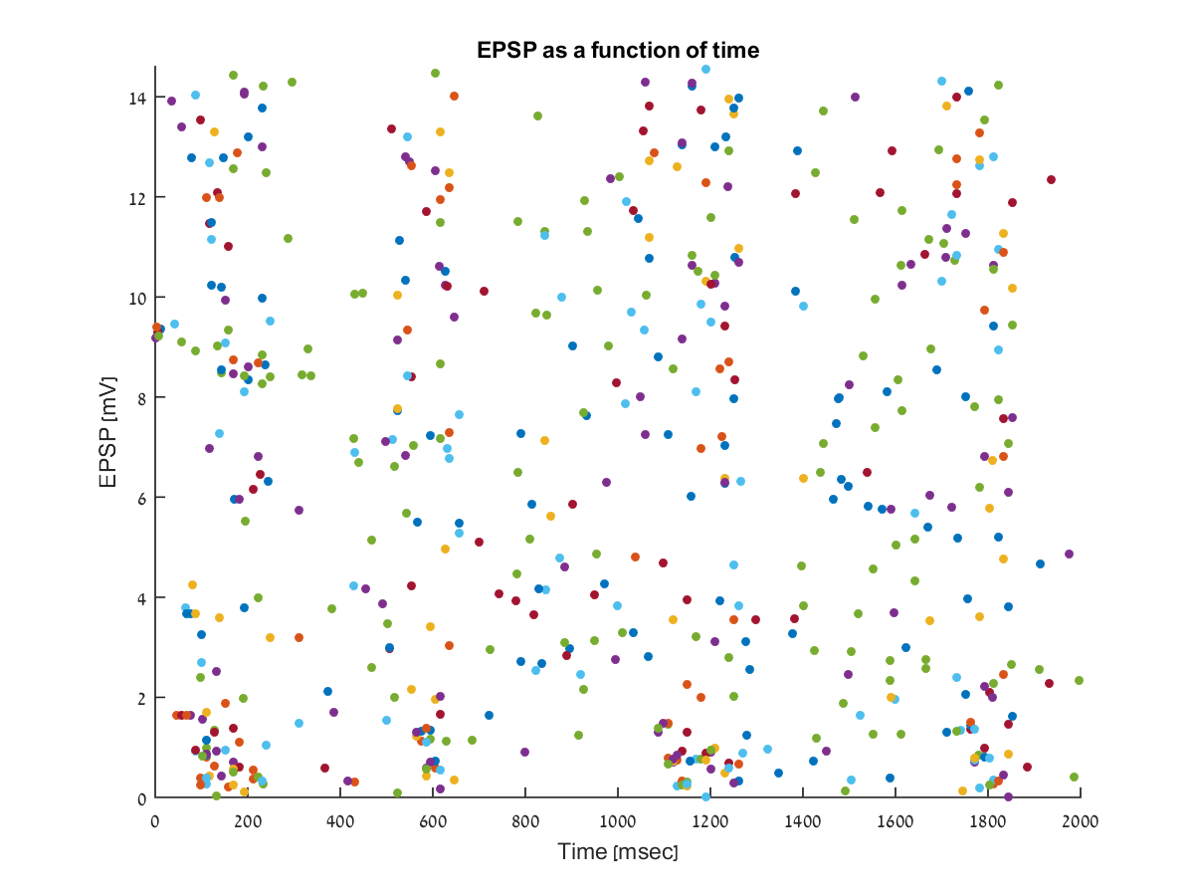
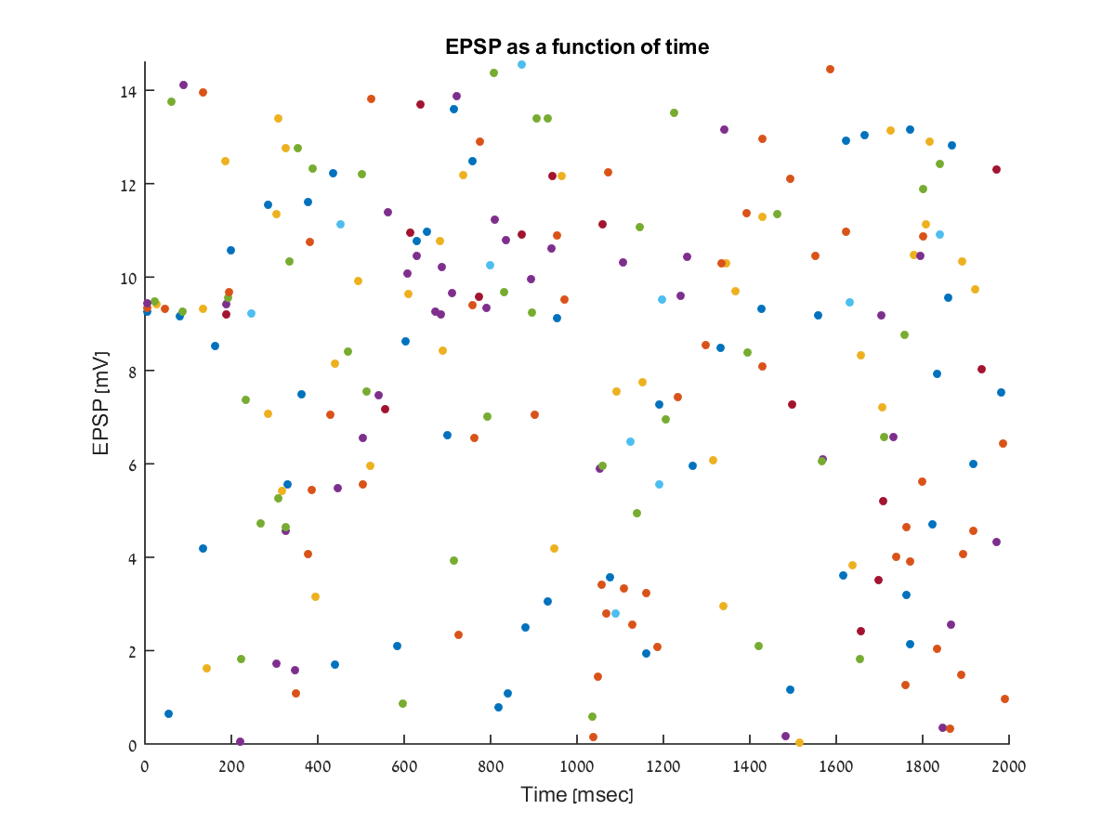
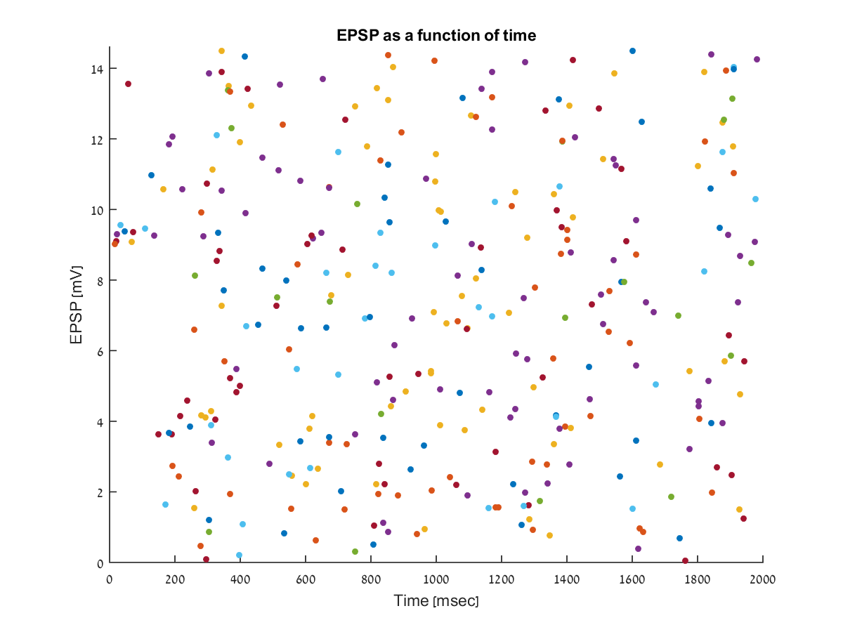
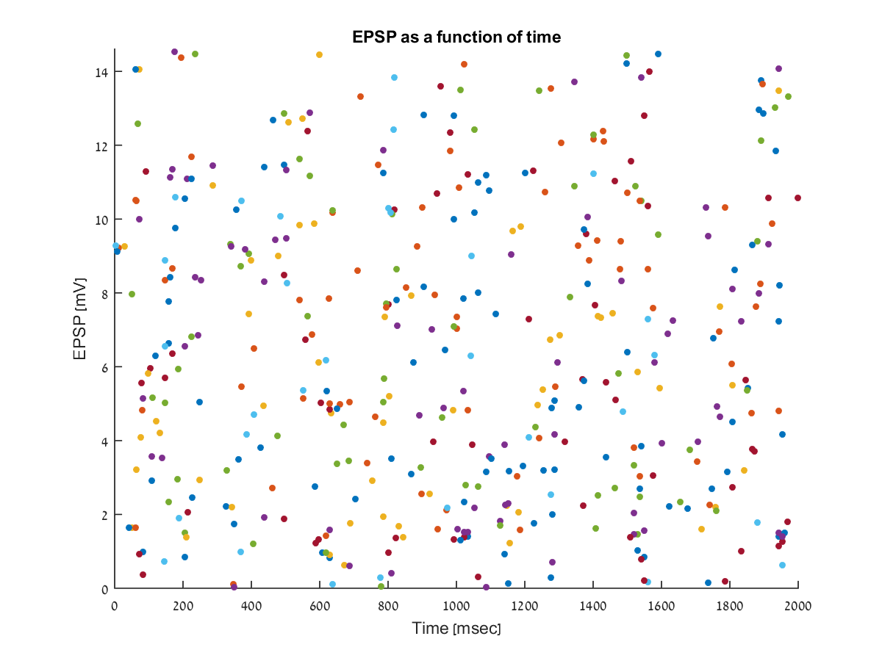
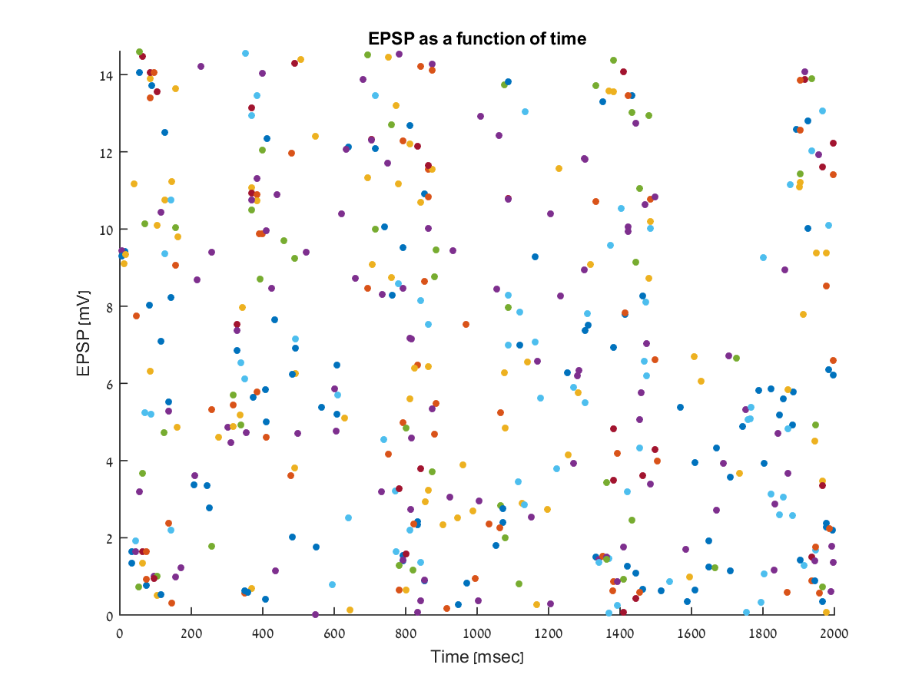
EPSP size
These plots show the peak amplitude of all post synaptic neurons.
Each color represents a different neuron.
These figures do not show neurons which passed the threshold potential

Slide 23
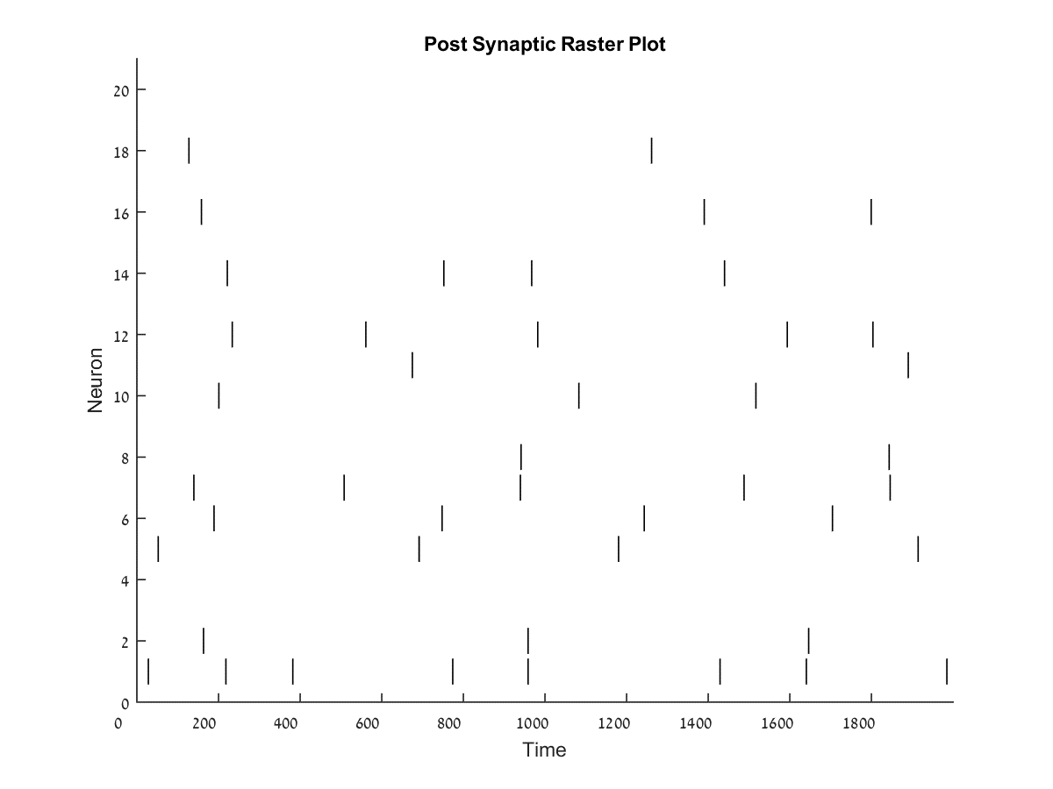
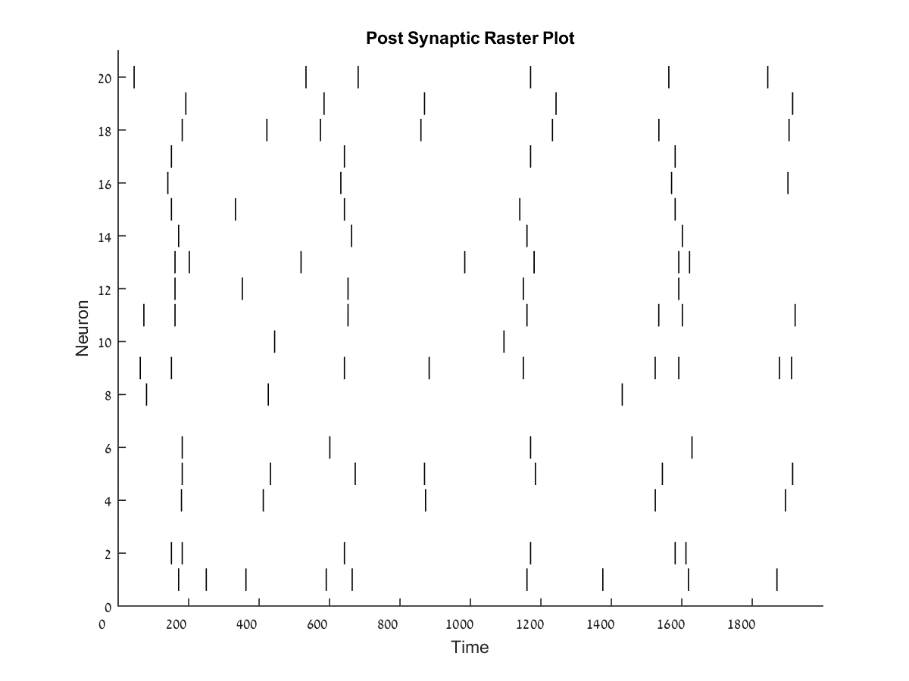
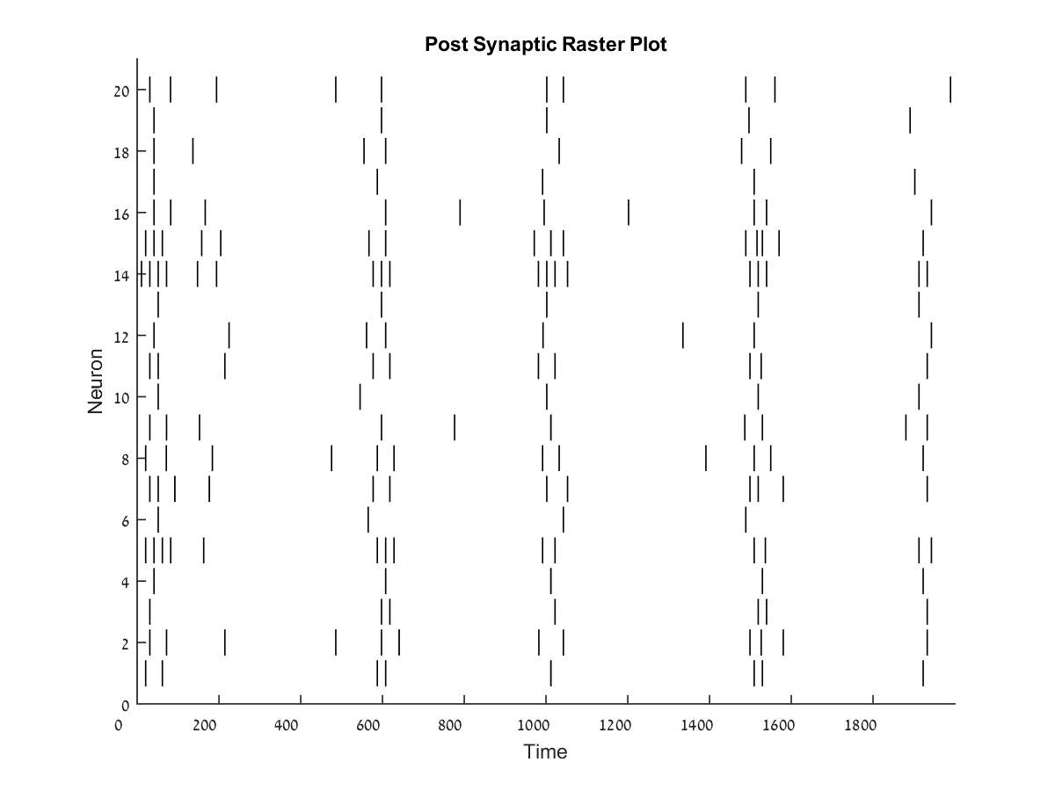
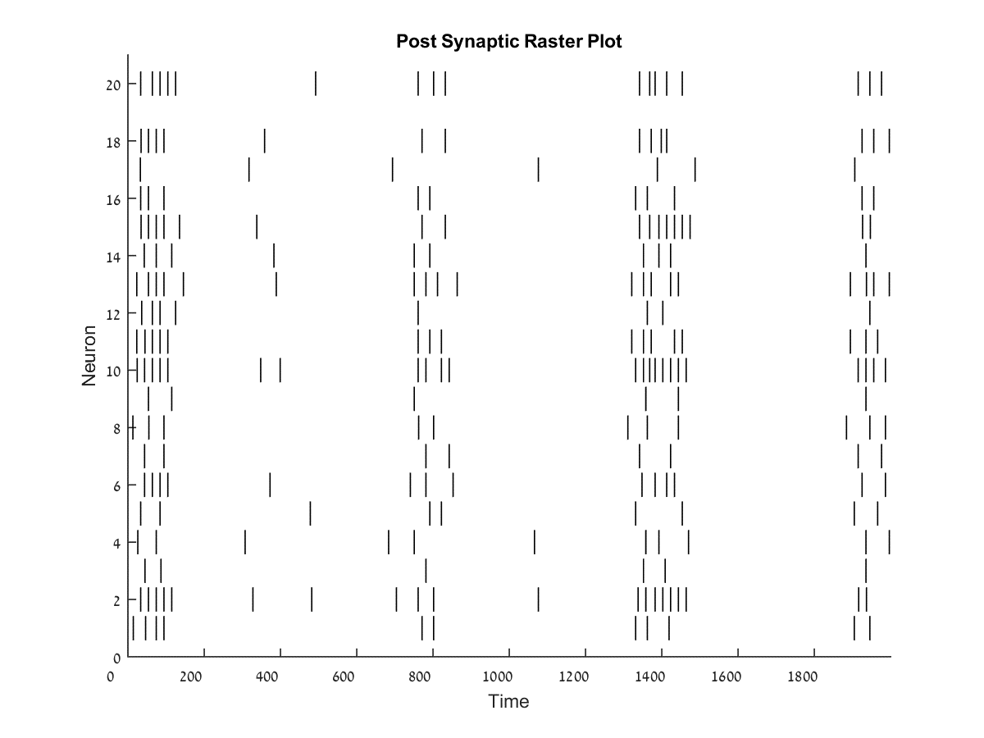
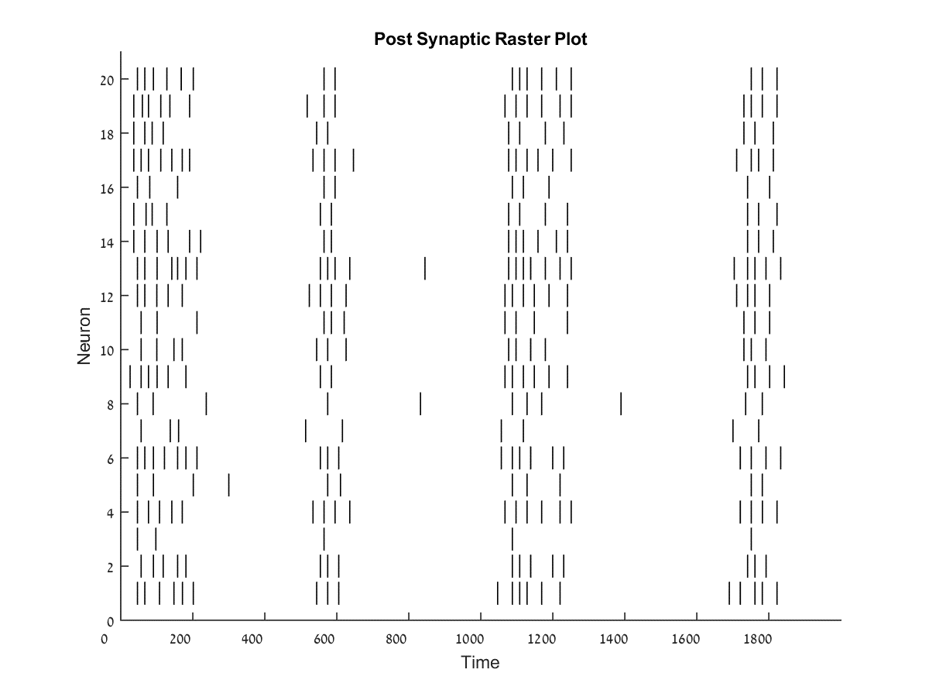
Post synaptic raster plot
Here we can view the post synaptic raster plot.
These figures show the number of neurons that passed the threshold potential in the simulation.

Slide 24
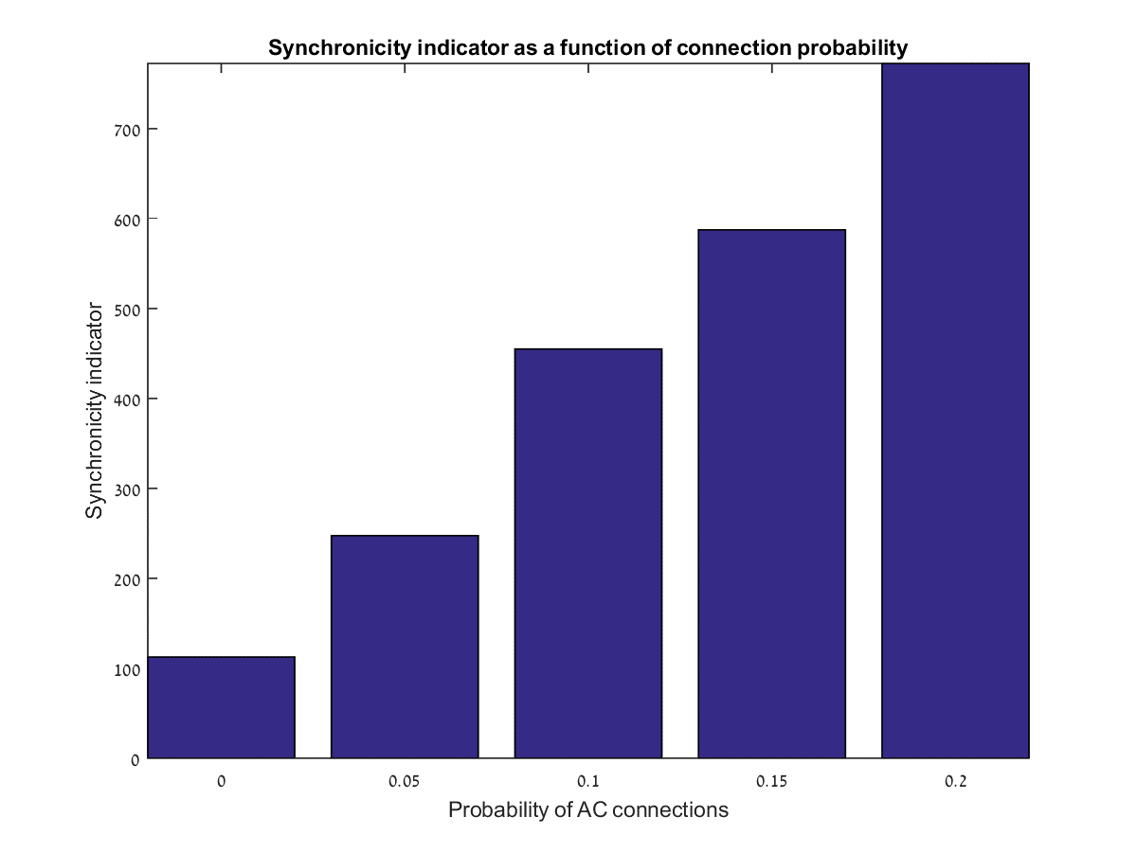
Synchronicity Indicator
As we can see from the synchronicity indicator, increased probability of connection in the CA3-CA3 network leads to increased synchronicity in the entire network.

Slide 25

Number of post synaptic spikes
Here we see the total number of post synaptic spikes that occurred in each of the simulations.
In order for us to be able to compare it to other simulations in future use, we normalized the results by dividing by the total number of post synaptic neurons.
We can see that increased connection probability leads to a more active network.

Slide 26
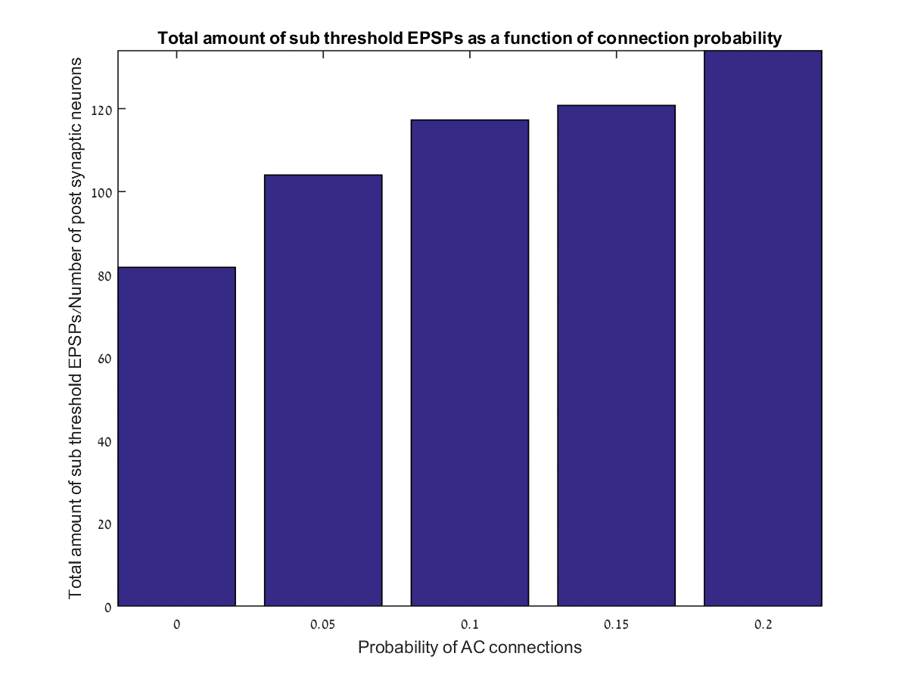
Total amount of subthreshold EPSPs
In order to complete the picture of our network, we summed up all the subthreshold EPSPs that occurred in the network.
This once again proves that the network is more active when there is a higher probability of CA3-CA3 connections.

Slide 27
Simulation 3 - conclusion

Slide 28
Simulation 4
Network response to varying model parameters with inter-spike-interval and inter-burst-interval spikes

Slide 29
Inter-Spike-Interval and Inter-Burst-Interval
In this simulation instead of a Poisson firing rate for the presynaptic spikes, we set a new distribution for the spikes which uses the concept of inter-burst and inter-spike intervals.
ISI
IBI
Firing probability
Time since last spike

Slide 30
Testing the ISI and IBI distribution
In order to test if the firing pattern follows the distribution function we defined, we ran the function for 100 trials with 3 neurons in each trial.
For each trial we counted how many spikes are located within a certain “window” of time since the last spike.
We plotted a histogram of these results and expected to get a histogram looking like the original probability function.
Also, in order to test the firing rate we binned the results and created a histogram showing the distribution of the firing rate throughout the trials.
Number of trials
Firing rate
Number of spikes
Time since last spike

Slide 31
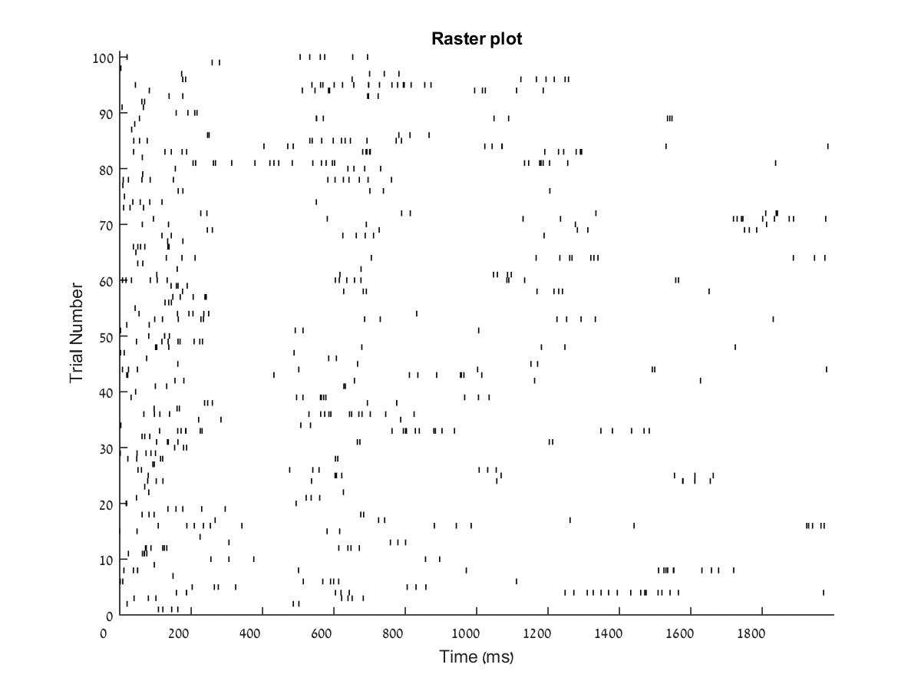
Pre synaptic raster plot
For this simulation, we set the average firing rate to 10Hz.
As you can see, the firing patterns follow the inter-spike-interval and the inter-burst-interval patterns.
We’re getting a lot of periods where the neurons do not fire at all and then we’re getting a sudden burst of firing.
As expected, we’re getting an average of 20 spikes per neuron in a 2 second simulation.

Slide 32
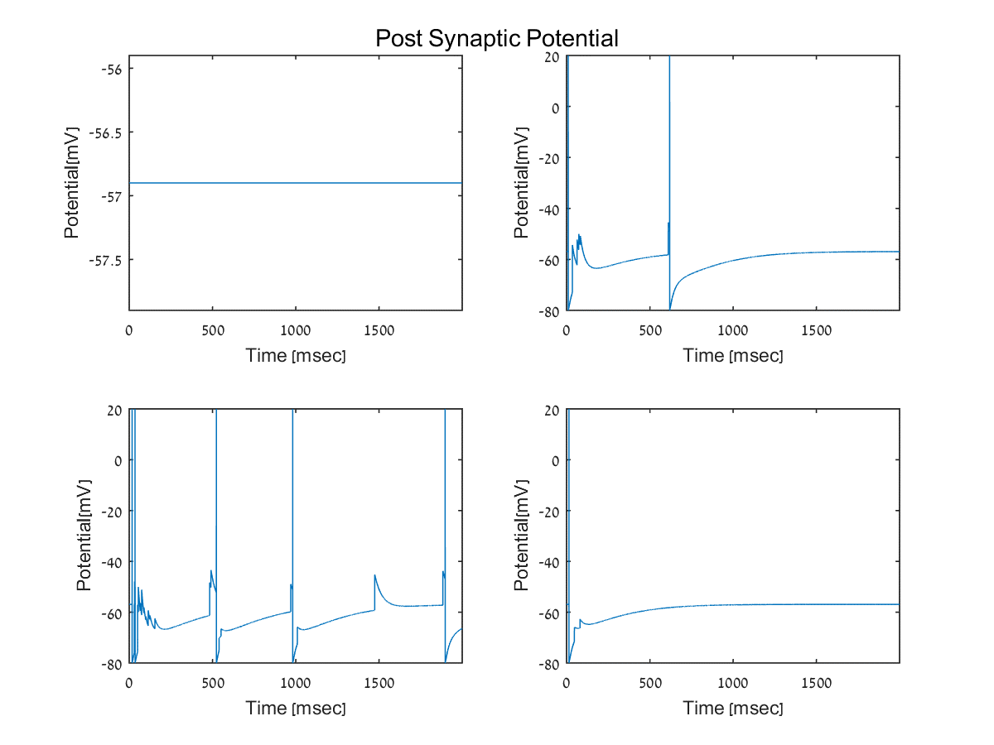
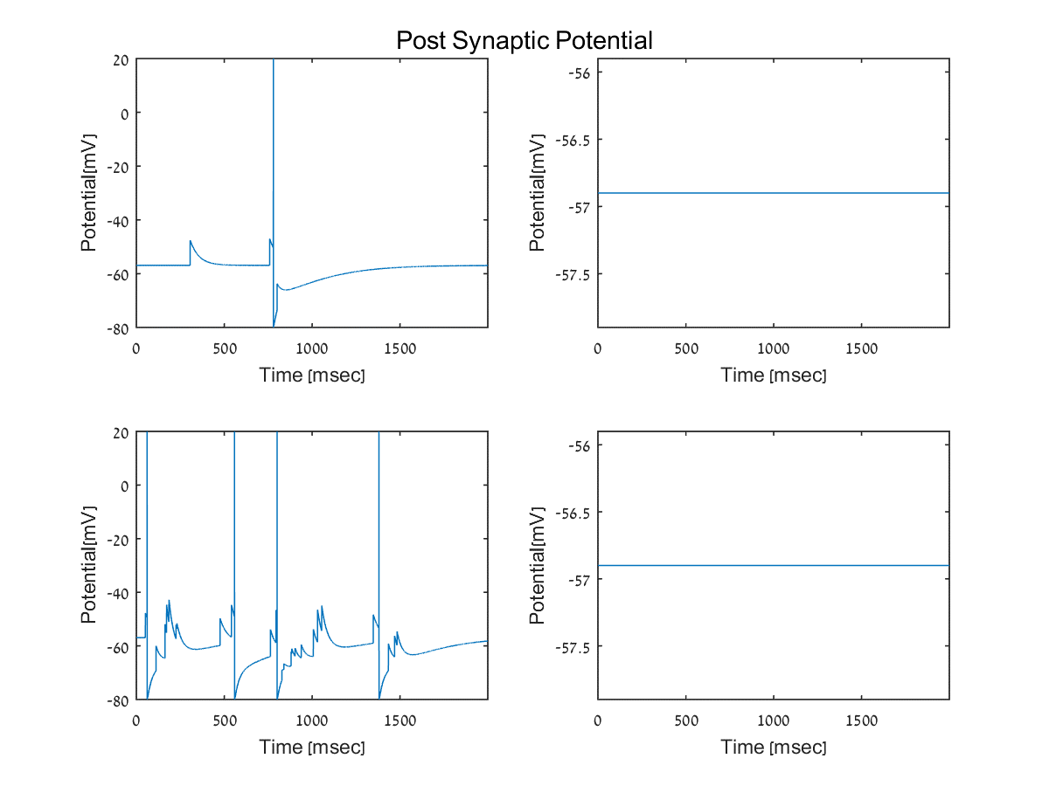



Post synaptic potential
Here we can see the post synaptic potential of 4 neurons for each mode.
This is just an example of for each mode.

Slide 33





EPSP size
These plots show the peak amplitude of all post synaptic neurons.
Each color represents a different neuron.
These figures do not show neurons which passed the threshold potential

Slide 34





Post synaptic raster plot
Here we can view the post synaptic raster plot.
These figures show the number of neurons that passed the threshold potential in the simulation.

Slide 35





Average EPSP size as a function of interval passed since last EPSP
Here we can see the average size of the EPSP as a function of the interval passed since the previous presynaptic spike.
The time interval used is 50msec.
Notes:
I think that we’re not getting any close enough EPSPs in the depression mode and this is why the figure looks like that. Ohad Doron 29/04/2016

Slide 36

Synchronicity indicator

Slide 37

Number of post synaptic spikes

Slide 38

Total amount of subthreshold EPSPs

Slide 39
Simulation 4 - Conclusions

Slide 40
Simulation 5
Adding Associational Commissural connections at different levels while using the ISI and IBI presynaptic firing

Slide 41
General
For this simulation, we used the firing patterns described in the previous simulation.
On top of these firing rates, we added a gradient of associational commissural connections probability rate.

Slide 42



Associational commissural connectivity maps
Here we can view the connectivity map of the CA3-CA3 network.
The CA1-CA3 connectivity is the same for each of these modes.

Slide 43




EPSP size
These plots show the peak amplitude of all post synaptic neurons.
Each color represents a different neuron.
These figures do not show neurons which passed the threshold potential

Slide 44




Post synaptic raster plot
Here we can view the post synaptic raster plot.
These figures show the number of neurons that passed the threshold potential in the simulation.

Slide 45

Synchronicity Indicator

Slide 46

Number of post synaptic spikes

Slide 47

Total amount of subthreshold EPSPs

Slide 48
Simulation 5 - conclusion

Slide 49
Simulation 6
Testing the model parameters on the whole network

Slide 50

General
For this simulation we used the same firing pattern shown in simulation 1 but we used it for the entire network.
The connection probability was still set to 0.01 so now we have neurons firing at a predefined rate and we can test the post-synaptic response.

Slide 51





Testing the model parameters
Here we see the behavior of the post synaptic potential as well as the synaptic parameters behavior and the presynaptic spikes over time.

